Slide 1
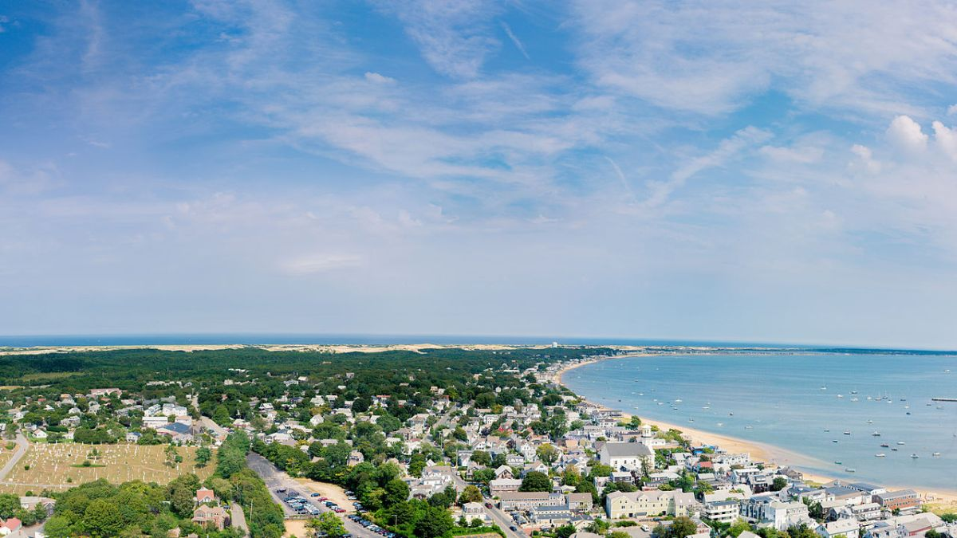
Massachusetts Climate Careers: Powering the Future
My Future in Clean Energy and Climate Tech
Lesson 1. Understanding and Combating Climate Change
|
1
Notes:
Welcome students to the final lesson.
Briefly review the journey they’ve taken through the course, including climate solutions and careers supporting them.
Today’s focus will be personal reflection and career evaluation to help students identify pathways in the clean energy and climate tech sectors that interest and excite them.

Slide 2
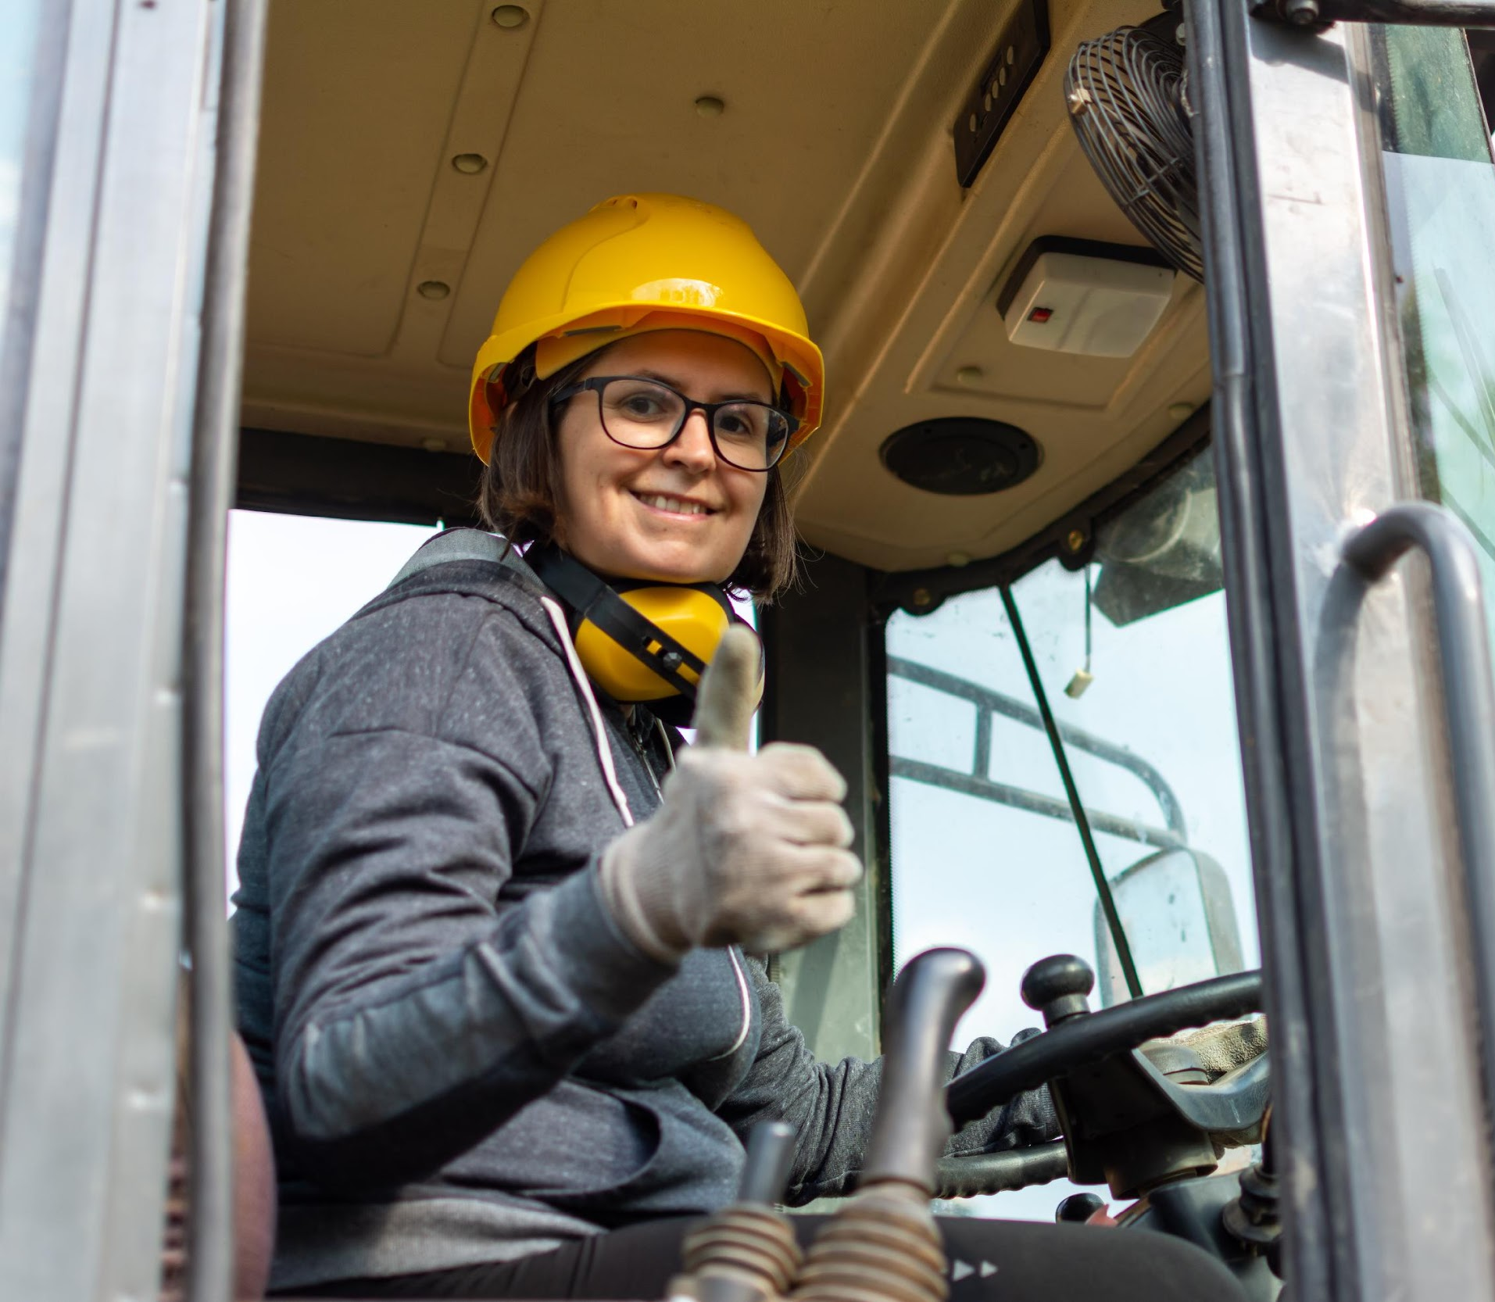
Today’s Agenda
Reflect on What We’ve Learned
Explore Careers and Solutions
Personal Skills, Interests, and Goals
Create a Personal Career Path Reflection
Lesson 18. My Future in Clean Energy and Climate Tech
Notes:
Quickly introduce the lesson structure so students know what to expect.
Today’s lesson will differ from previous lessons.

Slide 3
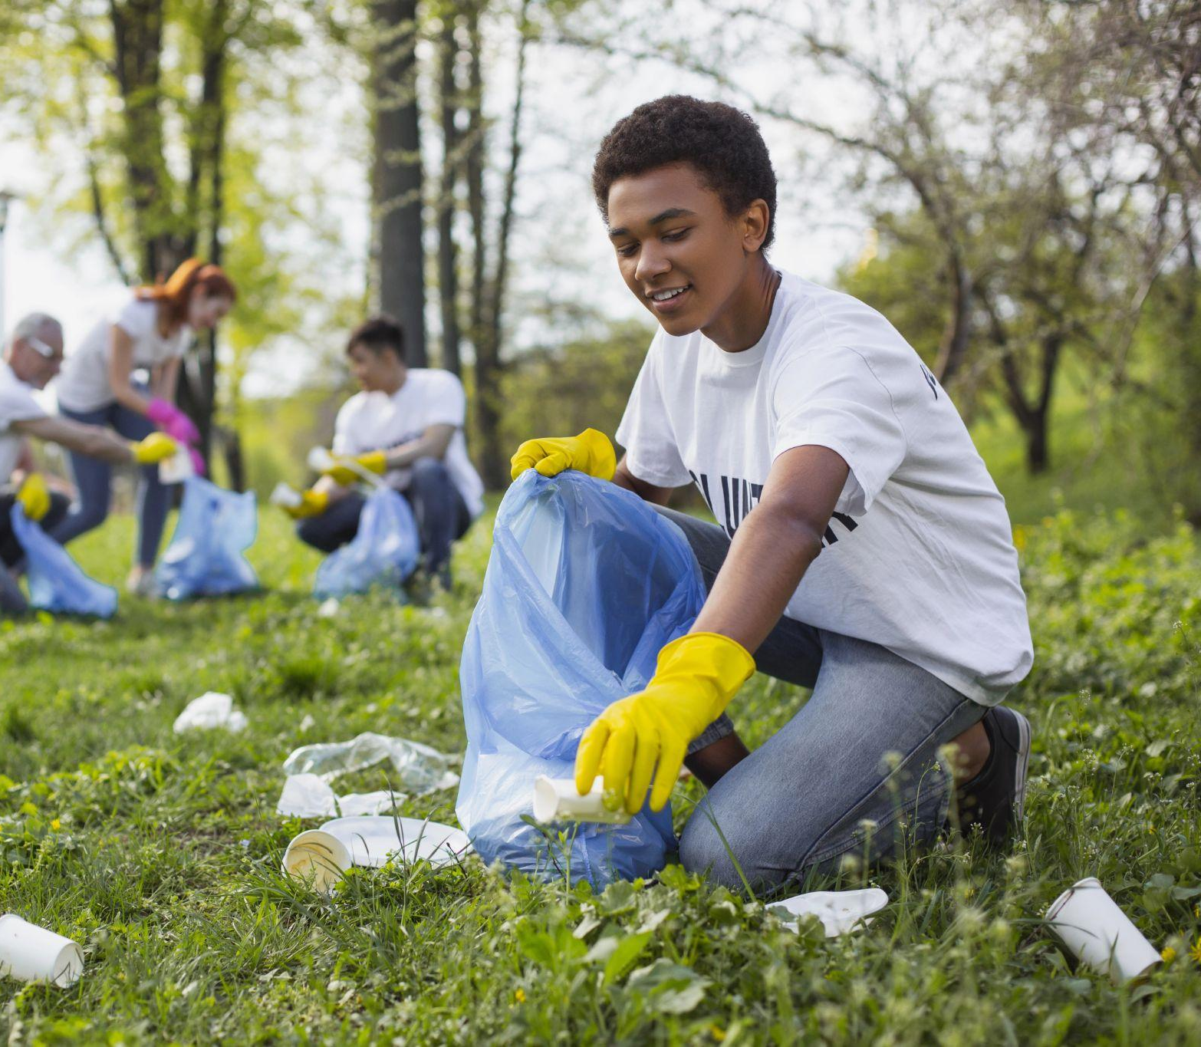
What role can I play in climate solutions?
The Big Question
Lesson 18. My Future in Clean Energy and Climate Tech
Notes:
Today’s lesson is a chance to think about your role in climate solutions and clean energy and to connect this to possible career paths.

Slide 4
When you complete this lesson, you’ll be able to
Reflect on climate-critical careers and climate solutions discussed in the course
Evaluate different career paths based on your skills, interests, and values
Connect personal strengths with potential career paths in clean energy
Articulate your role in climate solutions and how you envision contributing to a sustainable future.
Lesson 18. My Future in Clean Energy and Climate Tech

Slide 5
Opening Activity
What is your most significant takeaway from this course?
Lesson 18. My Future in Clean Energy and Climate Tech
Notes:
Instructions
Ask students to reflect individually on their most significant takeaway from the course.
Students should consider what they learned about climate change, solutions, or careers that surprised them, inspired them, or changed the way they think.
After a few minutes of individual reflection and writing, invite a few students to share their thoughts with the class.
Connect these reflections to the course’s key objectives, highlighting the importance of understanding the impact of climate and the roles that individuals can play in climate solutions.

Slide 6
Self-Evaluation
Skills
What am I good at?
Interests
What topics or activities excite me?
Work Environment
What kind of setting do I work best in?
Values
What motivates me in a career?
Lesson 18. My Future in Clean Energy and Climate Tech
Notes:
Self-Evaluation
Review/present the four contributing factors for career evaluation on the screen: skills, interests, values, and work environment.
Direct students to their worksheets, guiding them through a self-evaluation, and encouraging them to write down responses for each question.
This should feel familiar because it’s similar to what they did in lesson 10 when they first discussed evaluating career options.
These reflections will help them identify climate careers aligning with their strengths and interests.
Remind them that these answers are likely to continue changing, and there is no right or wrong answer or answers!

Slide 7
Career Path (Re)Exploration
Electrician/Solar Installer
Energy Auditor
HVAC Technician
Wind Turbine Technician
Engineer
Analyst
Project Manager
Sales & Customer Service Rep
What other careers from this course stand out to you?
Lesson 18. My Future in Clean Energy and Climate Tech
Notes:
Each career contributes to the climate goals we’ve covered in this course in different ways.
One by one, quickly recap these career paths by asking students to summarize what each of these roles does and how they contribute to climate solutions and achieving Massachusetts’s climate goals.
Encourage students to think about which roles resonated with them most as they prepare for the next activity.

Slide 8
Group Activity
In small groups, analyze the provided job descriptions, and identify the skills, interests, and preferences that align with each role.
Lesson 18. My Future in Clean Energy and Climate Tech
Notes:
Activity objective: Help students start connecting personal qualities with potential career paths.
Group activity: Analyzing job descriptions
Instructions:
Divide students into small groups and assign them to one of the roles provided on their worksheets: energy auditor, solar project manager, or electric vehicle technician.
Each group will analyze a job posting for their assigned role provided in their worksheets and discuss how specific skills, interests, values, or work environment preferences align with their assigned role.
Role job descriptions provided:
Energy auditor
Solar project manager
Electric vehicle technician
After 8–10 minutes, invite each group to share insights about how their group aligns with the role and how each role contributes to a more sustainable future.
Encourage students to think critically about how each role's skills and work environment relate to their personal interests.
Reinforce the idea that all these roles contribute to the same larger goal.
If students finish discussing their assigned role before the group time is finished, they are welcome to read and discuss one of the other two roles.

Slide 9
My Future
in Clean Energy
What are three climate-critical roles that interest you?
What are two skills useful to the clean energy sector that you would like to develop further?
What is one next step you can take to explore a career in clean energy?
Lesson 18. My Future in Clean Energy and Climate Tech
Notes:
Individual Capstone Activity: My Future in Clean Energy
Instructions:
This individual capstone activity encourages students to synthesize what they learned about climate-critical careers and career evaluation throughout the course.
Direct students to their worksheets for the Closing 3-2-1 Reflection. Individually, they should complete the following reflection prompts to help them answer the question: based on what you’ve learned, what role do you see yourself playing in climate solutions?
List three climate-critical career roles that interest you. These could be roles we discussed in class or others you learned about. Include why they interest you or what appeals to you.
What are two skills you would like to develop further? These could be skills you already have and want to improve, or skills you want to gain because they will be necessary for the future. This could be anything relevant to the clean energy industry: teamwork, technical skills, analytical thinking, communications, etc. Focus on growth areas that align with different clean energy roles.
Finally, identify one next step you can take to explore a career in clean energy. This could be something simple like researching a specific role or something more involved, like contacting a local organization about an internship or volunteer opportunity. It could be signing up for a particular class or elective focusing on one of those skills you want to develop. The next step should be actionable and achievable. It should build on what you’ve learned in this class and takes you one step further.
Encourage students to look through past activities and worksheets to refresh their memories about roles and how they felt about different skills, reflections, and careers throughout the course.
After the time is up, invite a few students to share if they feel comfortable, connecting their reflections to the real-world impact of their contributions.

Slide 10
Before You Go
Closing Activity
What is one word that describes how you feel about your future in climate solutions?
Lesson 18. My Future in Clean Energy and Climate Tech

Slide 11
Key Points
Your strengths, interests, and motivations can help you find a fulfilling and climate-critical role in the clean energy sector.
Roles of all types, with all levels of training and expertise, contribute to creating a sustainable future.
Progress toward any career is made through individual steps.
Lesson 18. My Future in Clean Energy and Climate Tech

Slide 12
Thank you for exploring climate solutions and careers with us.
Your role in a sustainable future matters to Massachusetts!
This Photo by Unknown Author is licensed under CC BY-ND

