Slide 1
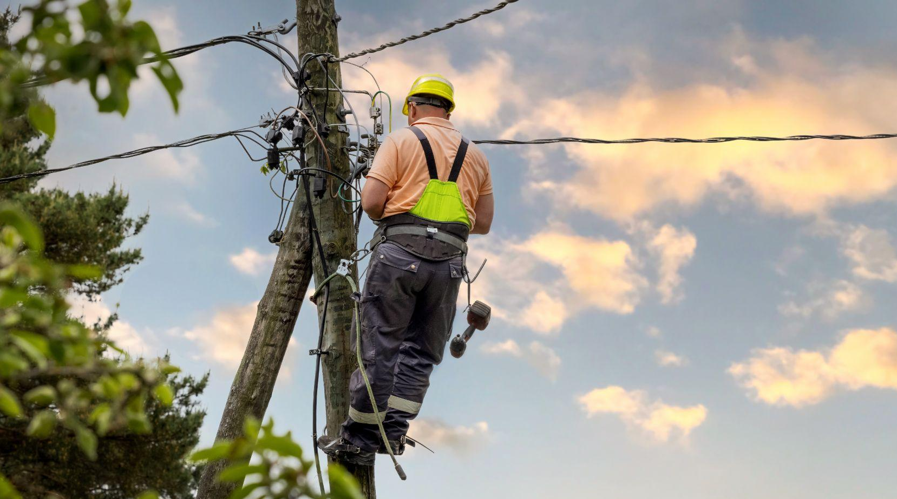
Massachusetts Climate Careers: Powering the Future
Climate Hero Spotlight: Lineworkers

Slide 2
Opening Activity
Power Runs Our Lives
How would a power outage affect
The pharmacist?
The corner grocery?
The crossing guard?
A taxi driver?
The hospital?
Lesson 13: Lineworkers
Notes:
Activity objective: To encourage students to connect with the idea of how vital electricity is to modern life, helping them understand why lineworkers are essential workers.
Instructions:
Assign each student pair or group of students a specific community role from the slide image.
Give students two minutes to discuss their main concerns if the power went out from the perspective of that role.
Encourage each group to share their most significant problems with the rest of the class.

Slide 3
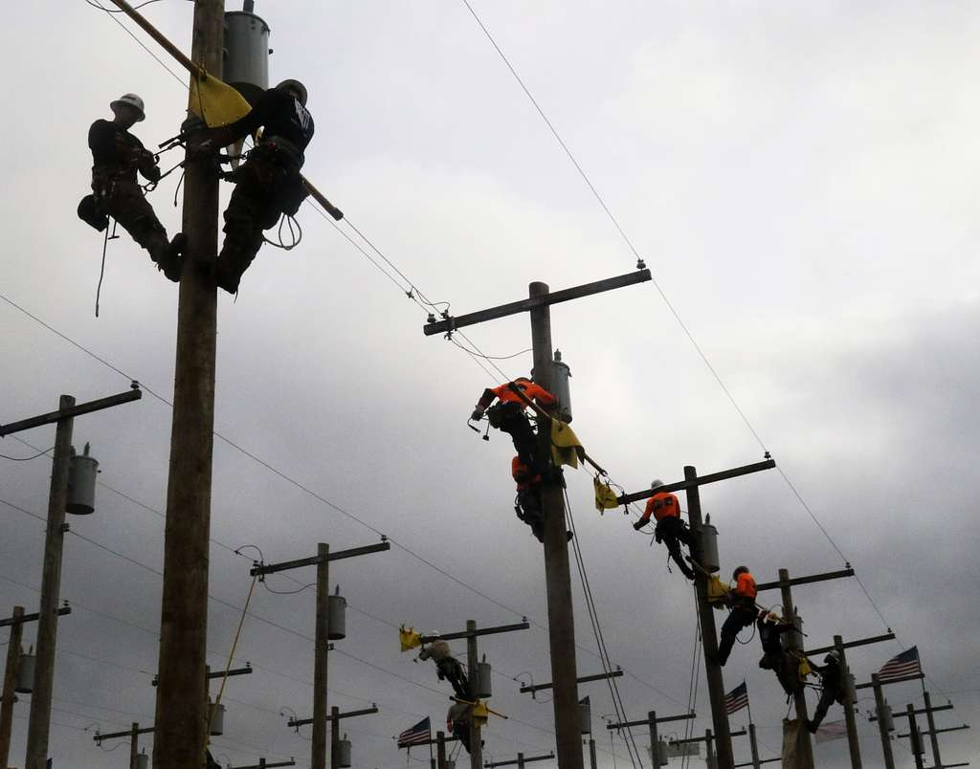
The Big Question and My Climate Goals
Lineworkers and Climate Resilience
Lineworker Career Paths
Lineworker Critical Response Scenarios
Takeaways and Closing
Lesson 13: Lineworkers
Notes:
Image: Creative Common license, Public Domain.
Teams from the 249th Engineering Battalion, U.S. Army, competing in the International Lineman’s Rodeo at the National Agricultural Center and Hall of Fame in Bonner Springs, KS.

Slide 4
How do lineworkers and other electric utility workers contribute to climate solutions?
Lesson 13: Lineworkers
Notes:
Today, we’re interested in exploring the big question: How do lineworkers and other electric utility workers contribute to climate solutions?

Slide 5
When you complete this lesson, you’ll be able to
Examine the role of lineworkers and how they contribute to climate resiliency and public safety
Discuss the relationship between lineworkers and the state’s climate goals
Identify the skills and training needed to become an electrical lineworker
Determine which aspects of a lineworker’s career align with their skills, interests, and desired work environment.
Lesson 13: Lineworkers
Notes:
Start by asking students whether they have ever experienced a power outage. Encourage them to share how that event impacted their daily lives (e.g., loss of Wi-Fi, heat, or lighting).
Ask them to think about the people who restore the power in these scenarios—introducing the idea that lineworkers are crucial to maintaining modern life.
Mention that Massachusetts’s climate goals will increase the electricity demand, making lineworkers even more essential.
Key points to emphasize:
Connect the role of lineworkers to larger climate goals: The need for more electricity from renewable sources means more infrastructure to maintain.
Point out that by the end of the lesson, they should understand the responsibilities and opportunities in a lineworker’s career.
Possible student questions:
Why are lineworkers so important for climate solutions?
Lineworkers build and maintain the infrastructure supporting renewable energy sources and electrical transportation systems. Without their work, we couldn’t achieve large-scale electrification goals.

Slide 6
Lineworkers
Lineworkers keep electricity flowing so homes, schools, and hospitals can function.
Install and repair power lines
Respond to outages in all weather
Help modernize the grid for clean energy
Lesson 13: Lineworkers
Notes:
Explain that lineworkers are essential workers who help maintain a critical service: Electricity.
Outline the role of lineworkers in keeping modern life running smoothly, from homes to schools to hospitals.
Explain that they work in urban, rural, overhead, and underground environments.
Encourage students to think about their daily reliance on electricity and what life would be like without it, connecting this to the opening activity.
Ask students to imagine a winter storm where power lines are down. Use this scenario to stress that lineworkers are essential first responders in many ways.
Mention that lineworkers often work in dangerous conditions, such as after a storm, to make repairs and prevent further damage.
Key points to emphasize:
Lineworkers are highly skilled in both installation and emergency repairs.
They maintain above-ground lines (poles and wires) and underground systems (cables and conduits). Their work involves a mix of physical labor and technical expertise.
Possible student questions:
How dangerous is being a lineworker?
It can be hazardous due to exposure to high-voltage electricity, heights, and weather, but lineworkers are trained in strict safety protocols to minimize risk.

Slide 7
Build a Cleaner Future
Lineworkers help upgrade power grids to support clean energy:
New solar, geothermal, wind, and other renewable energy projects
Electrifying buildings and infrastructure
Electric vehicle charging capability
Strengthening the grid against climate events
Lesson 13: Lineworkers
Notes:
Discussion guidance:
Tie the role of lineworkers to Massachusetts’s climate goals: transitioning to clean energy sources and modernizing the grid for electric vehicles and buildings.
Highlight that we need more infrastructure as we add more renewable energy, such as solar and wind. Lineworkers will be on the front lines, building and maintaining this infrastructure.
As the climate changes, we’ll experience more extreme weather, making a reliable power grid even more critical for public safety and climate resilience.
Describe how a modern, resilient grid will help to prevent outages caused by increasing storms and weather events due to climate change.
Key points to emphasize:
Lineworkers are critical to responding to climate emergencies. Without them, public safety and infrastructure would be at much greater risk.
They are also responsible for building the infrastructure necessary for Massachusetts to achieve its climate goals—especially for solar and wind energy.
Possible student questions:
What is climate resilience?
It refers to how well a community or system can withstand and recover from climate-related impacts, such as storms or heat waves. A resilient power grid maintained by lineworkers is essential for this.

Slide 8
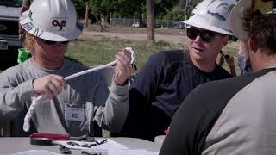
Climate Watch Video
Lesson 13: Lineworkers
Notes:
Note to teacher: This video is a placeholder; the video created for this course will be available in spring 2025. You may skip this slide and the next if you wish.
Video: A Day in the Life of a Lineworker Apprentice
Introduce the video: A day in the life of of someone going through an apprenticeship program to become a journeyman lineworker.
https://youtu.be/ANlNKCGnyeY?si=WsdNE7IRjLBIS6B5
Produced by the Utah Department of Workforce Services. The lineworkers featured in this video work in Salt Lake City, UT.
For later (MassCEC video)
Lineworkers protect public safety in climate emergencies.
Climate-related weather events are becoming more frequent and intense, increasing the need for lineworkers to respond quickly to emergencies.
Lineworkers protect public safety by ensuring that critical infrastructures such as hospitals and emergency services have power.

Slide 9
How similar (or different) are the apprenticeship programs for electricians and lineworkers?
What is one challenge of pursuing an apprenticeship mentioned in the video?
What are some of the benefits of the pursuing an apprenticeship to be a lineworker?
Climate Watch Discussion
Lesson 13: Lineworkers

Slide 10
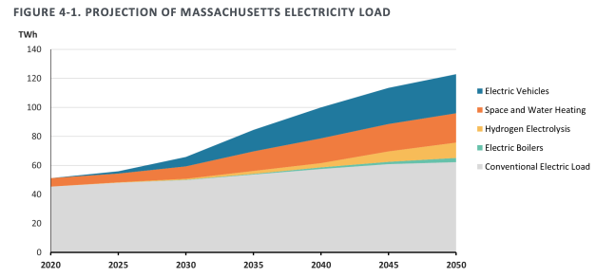
Massachusetts’s Climate Plan
Lineworkers are essential to meeting climate goals.
Source: MA Clean Energy and Climate Action Plan for 2050
Lesson 13: Lineworkers
Notes:
Discussion guidance:
Ask the students whether Massachusetts can reach its climate goals without upgrading the power grid. Help them to understand that the state’s success in reducing emissions depends on workers such as lineworkers building and maintaining the necessary infrastructure.
Massachusetts aims for net-zero emissions by 2050, meaning we will use much less fossil fuel and rely more on renewable energy sources.
Key points to emphasize:
Lineworkers are critical to achieving this goal because renewable energy (such as wind and solar) needs to be transported across the state, which requires updated power lines and infrastructure.
Due to these changes, many new jobs will be created, offering promising career opportunities for students.

Slide 11
Lineworker Demand
Demand for lineworkers will double by 2030 to maintain wind, solar, and battery infrastructure and to build new power lines for clean energy.
Lesson 13: Lineworkers
Notes:
Discussion guidance:
Explain that Massachusetts has ambitious climate goals, such as electrifying buildings and switching to electric vehicles (EVs), but all of these require a much more robust power grid.
Point out that upgrades are needed, which means more lineworkers are required.
Discuss how Massachusetts will need almost double the number of lineworkers by 2030 to support the clean energy transition.
Encourage the students to think of lineworkers as “climate heroes” who will help the state meet its net-zero goals by maintaining and upgrading the grid.
Mention specific projects, such as wind farms or solar energy storage, directly tied to the work of lineworkers that students have already discussed in previous lessons.
Key points to emphasize:
Lineworkers will be critical to ensuring the distribution of renewable energy sources throughout the state, such as wind and solar.
Expanding the electrical grid is not just about adding more power—it’s also about making it more resilient and able to handle climate emergencies.
Possible student questions:
What exactly does “electrification” mean?
Electrification means using electricity to power things that traditionally used fossil fuels, such as cars (electric vehicles) and buildings (electric heating).

Slide 12
Prevailing wage rates can be higher.
Lesson 13: Lineworkers
Notes:
Wages vary, but the median in Massachusetts is about $48 per hour. There are also many opportunities for overtime, especially during emergencies.
Many jobs and projects for lineworkers are subject to prevailing wage laws, which will have base pay rates that can be much higher than what you see here.
As demand for lineworkers increases, wages may increase, or organizations may offer increased benefits to attract and retain talent.

Slide 13
Skills and Training
Skills:
Technical proficiency
Physical stamina
Problem-solving
Safety awareness
Training:
Apprenticeships
Vocational programs
Lesson 13: Lineworkers
Notes:
Discussion guidance:
Start by asking students to list what skills they think would be necessary for a job like a lineworker.
Explain that this career doesn’t require a traditional college degree but requires specialized training and physical fitness.
Outline the job requirements. Lineworkers often work in challenging conditions, including during storms and emergencies.
Technical proficiency: Mastering electrical systems and telecommunication cables, understanding blueprints, schematics, and manuals. And lots of math!
Physical stamina: The ability to perform strenuous tasks like repeatedly climbing and lifting heavy objects
Problem-solving: Troubleshooting and repairing defects in the power line system
Safety awareness: Strict adherence to safety protocols and practices in high-risk situations; maintaining composure under pressure
A willingness to work during irregular hours and in various weather conditions
An ability to relay complicated technical information clearly and succinctly.
Discuss local apprenticeship programs and training schools in MA (examples are provided in the Teachers’ Guide, such as Middlesex Community College and union programs)
Most lineworkers receive three to four years of technical and on-the-job training after high school.
Lineworkers usually start as apprentices or ground workers, where they get hands-on experience and can learn from seasoned professionals before advancing to specialized roles such as journeyman or lineworker, which require additional years of experience and expertise.
Key points to emphasize:
• Lineworkers need strong problem-solving abilities because they often deal with unexpected challenges like storm damage.
• They must also be comfortable working safely at heights, in harsh conditions, and with high-voltage equipment.
Possible student questions:
Can anyone become a lineworker?
Many people can, but it requires physical ability, technical skills, and safety training. Apprenticeships are often the best way to enter the field.

Slide 14
Lineworker Career Paths
Become a journeyman or specialized technician.
Join one of Massachusetts’s training options, such as one of their apprenticeship programs!
Lesson 13: Lineworkers
Notes:
Discussion guidance:
Ask the students what they envision when they think about their future careers. Connect this to how linework can lead to a fulfilling, stable career without a traditional college degree.
Mention that many lineworkers advance into more specialized roles, such as substation technicians or engineers, after gaining experience.
Explain that there are several possible careers involved in the work you’re discussing today, including
Lineworkers or line repairers
Underground construction workers
Substation technicians
Electrical systems planners
Engineers for distribution and transmission
Project managers.
Three specific programs worth mentioning are
The Utility Technology Certificate program at Quinsigamond Community College
Excellent trades programs at Massasoit Community College
The Energy Infrastructure Academy through National Grid MA.
Key points to emphasize:
Linework offers opportunities for growth and specialization.
Massachusetts has several apprenticeship programs that provide hands-on training and a clear career path for young workers.

Slide 15
Group Activity
Critical Response: Lineworkers in MA Climate Emergencies
Winter Storm Riley
Tornado Outbreak
Heat Wave
Source: Live595.com
Source: Weather.com
Source: Boston Magazine
Lesson 13: Lineworkers
Notes:
Activity objective: To engage students in understanding the critical role of lineworkers during climate-related emergencies, highlighting their essential role in maintaining public safety and contributing to climate resilience.
Time suggestions:
Set up and explanation: Two minutes. Divide the class into three groups and assign each to a scenario. Provide the handouts for each scenario.
Group planning: Seven minutes. Each group will take on the role of lineworkers tasked with responding to their climate event. Their task is to develop a quick action plan, deciding which areas to prioritize and what safety concerns could affect their repairs.
Group presentations: Two minutes each (six minutes total). Each group will present its plan to the class, explaining its strategy, the risks involved, and how its response helps ensure public safety.
Debrief discussion: Five minutes. Class-wide discussion about how lineworkers' quick and effective response to emergencies ties into climate resilience and clean energy infrastructure. Summarize what the class learned to reinforce key points.
Instructions:
Divide the class into three groups and assign each to a scenario. Depending on the class size, you may have more than three groups, with more than one group working on each scenario.
Assign the students to the role of lineworkers tasked with responding to an actual climate event from the past few years in Massachusetts. They must
Analyze the scenario and town’s electricity grid schematic provided on their worksheet for their assigned scenario (Winter Storm Riley, Tornados, or Extreme Heat Wave)
Develop their quick action response plan, deciding which areas to prioritize and what safety concerns could affect their repairs.
They will present their plan to the class, explaining its strategy, the risks involved, and how its response helps ensure public safety.
Following their presentations, initiate a class-wide discussion about how lineworkers' quick and effective response to emergencies ties into climate resilience and clean energy infrastructure.

Slide 16
How do lineworkers contribute to climate solutions?
Why is their role critical in ensuring the safety and well-being of communities?
How does the ability to restore power during emergencies contribute to broader climate resilience goals, such as clean energy access and reliable infrastructure?
Activity Debrief
Lesson 13: Lineworkers
Notes:
Debrief discussion:
Ensure that each group includes how their team’s response contributed to public safety. This discussion will help connect the dots between climate events, lineworkers, and climate resilience.
Start by revisiting the Big Question from the beginning of the lesson: “How do lineworkers and other electric utility workers contribute to climate solutions?”
Discuss why their role is critical in ensuring the safety and well-being of communities.
Students should reflect on the immediate and future safety and well-being of individuals and communities.
They should observe that electricity powers everything from heat, water, locks, transportation, and communications to food safety and access.
Consider how the ability to restore power during emergencies contributes to broader climate resilience goals, such as clean energy access and reliable infrastructure.
As we transition to an electrified grid, more services will be connected to the grid and will, therefore, depend on our ability to restore electrical power quickly and safely.
Ask students to reflect on what they’ve learned and how their understanding of the role of lineworkers has changed. Encourage a few students to share their thoughts.
Guiding Questions for Closing the Discussion:
Why do you think lineworkers are crucial to achieving climate goals?
Encourage students to connect lineworkers' skills and responsibilities to the large-scale transition to renewable energy and electrification.

Slide 17
Lineworkers are essential workers.
Lineworkers contribute to climate resilience.
The demand for lineworkers will continue to grow in Massachusetts.
Linework requires a combination of physical and technical skills and training.
Lesson 13: Lineworkers
Notes:
Summarize key takeaways:
The essential role of lineworkers: Lineworkers are indispensable to keeping the electrical grid functioning. They are crucial in ensuring the transition to renewable energy sources and fighting climate change.
The connection between lineworkers and climate resilience: Lineworkers support daily electricity needs and are on the front lines of climate resilience. They keep critical infrastructure operational during storms and emergencies caused by climate change.
Career opportunities in the energy sector: A career as a lineworker offers a path to stable employment without needing a traditional college degree. It also provides opportunities for further specialization and growth.
Guide students toward further reflection:
Highlight that many roles (including lineworkers) will be crucial as we work toward climate solutions. There are opportunities for various skills and interests, from technical to managerial, hands-on to strategic.

Slide 18
Why are lineworkers critical to Massachusetts achieving its climate goals?
How do lineworkers contribute to climate resiliency?
What is one unique aspect of working as a lineworker?
Closing Activity
Lesson 13: Lineworkers
Notes:
Activity objective: To encourage students to reflect on key takeaways and identify areas of curiosity for further exploration.
Ask students to take one minute to think about the lesson and answer these questions:
Why are lineworkers critical to Massachusetts achieving its climate goals?
How do lineworkers contribute to climate resiliency?
What is one unique aspect of working as a lineworker?
Go around the room, asking students to share their answers.

Slide 19
|
19

