Slide 1
Climate Hero Spotlight: Engineers
Massachusetts Climate Careers: Powering the Future
Lesson 12: Climate Hero Spotlight: Engineers
|
1
Notes:
Today’s lesson is all about engineers and their role in climate solutions.
Students will explore how engineers design solutions that help to build a sustainable future.

Slide 2
Opening Activity
Design Thinking: How Would an Engineer Solve It?
Design a bookstand for student desks using only:
10 index cards
2 objects currently on your person (per person)
Use your worksheets to follow the design thinking process!
Lesson 12: Climate Hero Spotlight: Engineers
Notes:
Activity objective: Introduce students to the engineering design thinking process in a fun, engaging, and relevant way by having them brainstorm and plan an invention that addresses a classroom-related challenge.
Background: Clean energy projects often begin with a problem that needs to be solved. Today, you’ll practice design thinking and get creative!
Instructions
This activity can be done in pairs or small groups. Students should use their worksheets to follow the design thinking process.
Present the challenge: Students are to design a bookstand for student desks.
Each pair may only use ten index cards (total) and two objects currently found on their person (per person).
Students have five minutes—encourage them to move quickly, and don’t let perfectionism slow them down!
After five minutes, ask one or two groups to share their reactions to the activity and whether they would be excited to build and test their ideas.*
*This is an optional extension activity if you split this lesson over two days. More information is provided about the second portion in the Teacher’s Manual.

Slide 3
Today’s Agenda
The Big Question and My Climate Goals
Climate Watch and Discussion
Engineering Climate Solutions
Engineering Design Challenge
Takeaways and Closing
Lesson 12: Climate Hero Spotlight: Engineers

Slide 4
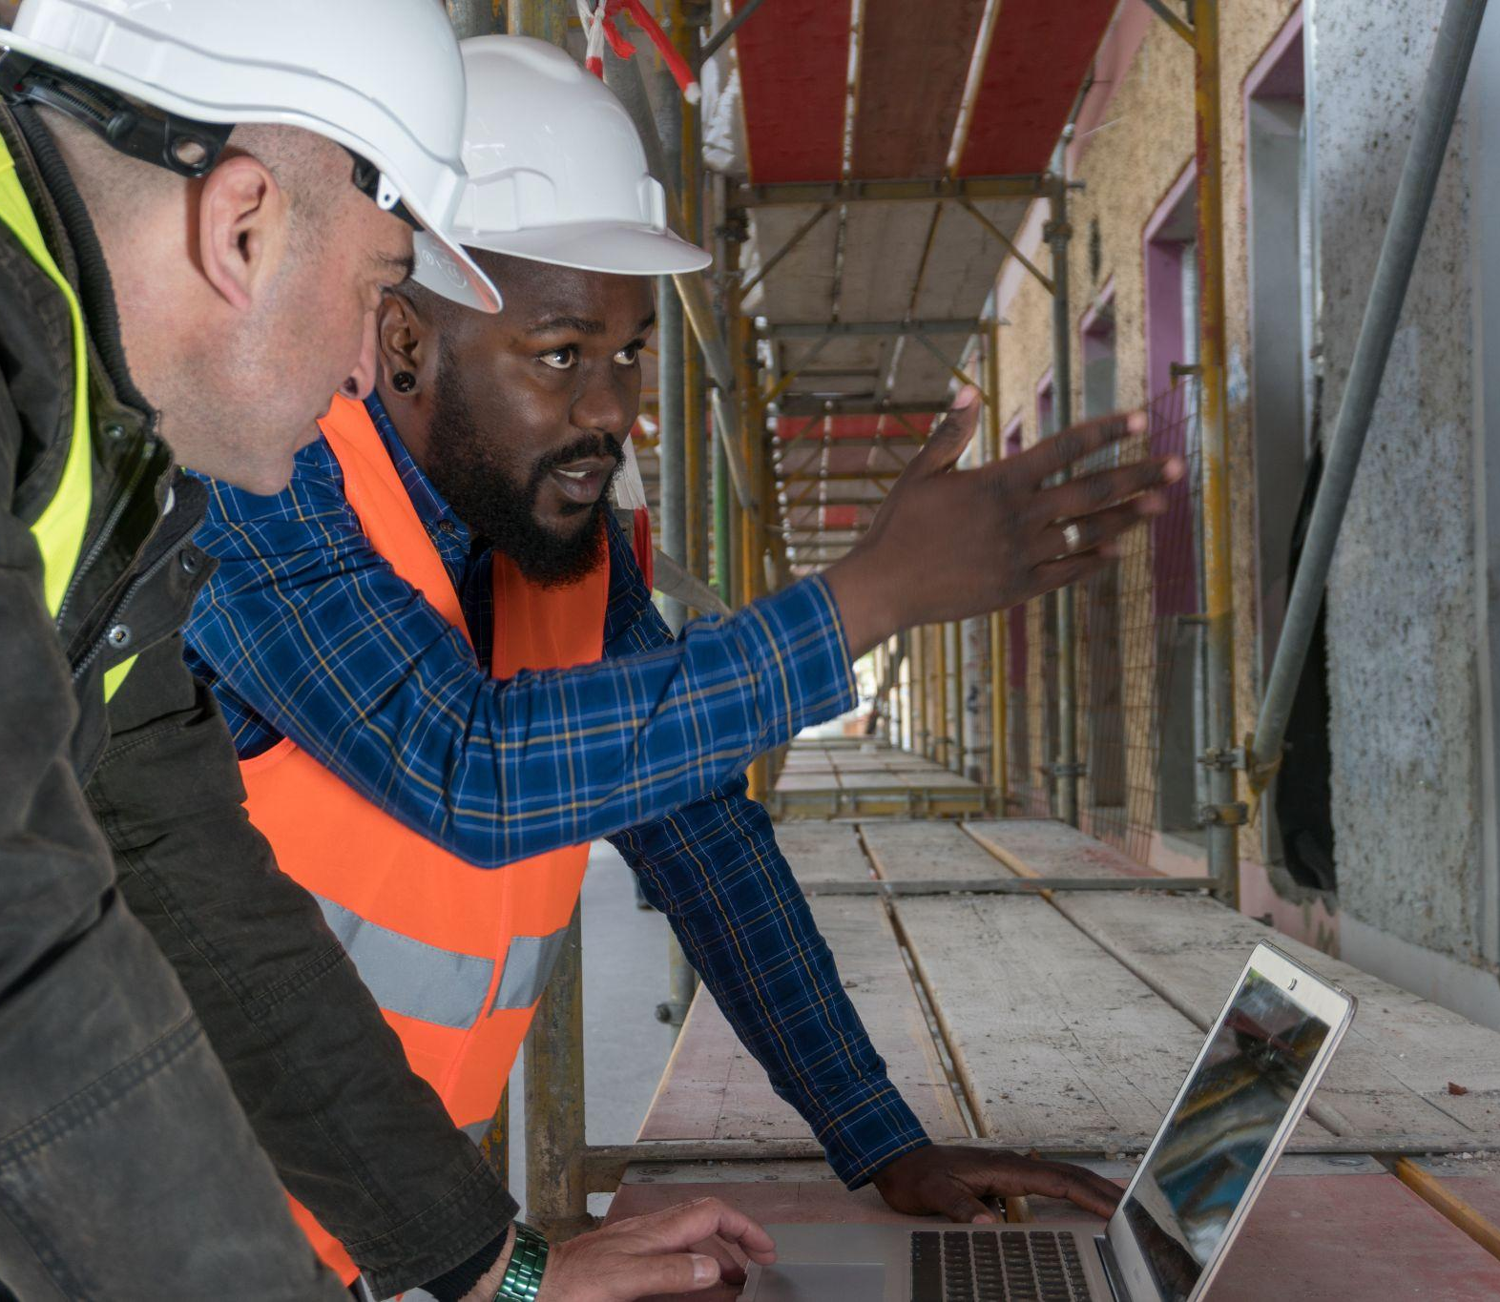
How do engineers play a critical role in designing climate solutions?
Lesson 12: Climate Hero Spotlight: Engineers
Notes:
Introduce today’s big question.
Encourage students to keep this in mind throughout the lesson.
By the end of the lesson, they’ll better understand how different engineering roles work together to make clean energy projects possible and successful.

Slide 5
When you complete this lesson, you’ll be able to:
Describe how engineers contribute to climate-critical projects.
Identify the skills and training needed for engineering careers.
Describe the aspects of an engineering career that align with your skills and interests.
My Climate Goals
Lesson 12: Climate Hero Spotlight: Engineers
Notes:
Briefly review today’s learning goals and how they connect to students’ real-world experiences.

Slide 6
Climate Watch: Video
Courtesy XXXXXX
Lesson 12: Climate Hero Spotlight: Engineers
Notes:
MassCEC video will be added by Spring 2025.
Engineer at the wind turbine testing center

Slide 7
What happens at the Wind Technology Testing Center?
What are some things that Carly enjoyed growing up that made her think engineering might be interesting to pursue?
Climate Watch Discussion
Lesson 12: Climate Hero Spotlight: Engineers

Slide 8
What Do Engineers Do?
Apply math and science to solve problems, overcome challenges, and produce solutions
Lesson 12: Climate Hero Spotlight: Engineers
Notes:
Engineers figure out how technology or creations can be used to solve real-world problems.
Engineers are educated to design, analyze, innovate, and communicate.
Studying engineering gives you a well-rounded education in science, math, design skills, communication, and entrepreneurship.
Engineers usually specialize in a focused field or discipline. Let’s examine some engineering specialties that are closely related to clean energy industries and technologies, climate goals, and innovation.

Slide 9
Engineering Roles in Clean Energy
Engineers design, build, and maintain climate solutions
Wind turbine engineer
Optimizes turbines for wind energy
Solar engineer
Designs solar power systems
Building systems engineer
Creates energy-efficient building systems
Lesson 12: Climate Hero Spotlight: Engineers
Notes:
Engineers use math and science to solve problems by designing, building, and improving systems and products in fields such as technology, energy, and construction.
There are several different types of engineers.
These are some of the most common career paths for engineers who work in the clean energy field.
Engineers tackle projects that make life safer, easier, and, ideally, more efficient.
Engineers play an essential role in developing technologies that combat climate change, such as solar and wind power products, systems, electric vehicles, and high-performance buildings.

Slide 10
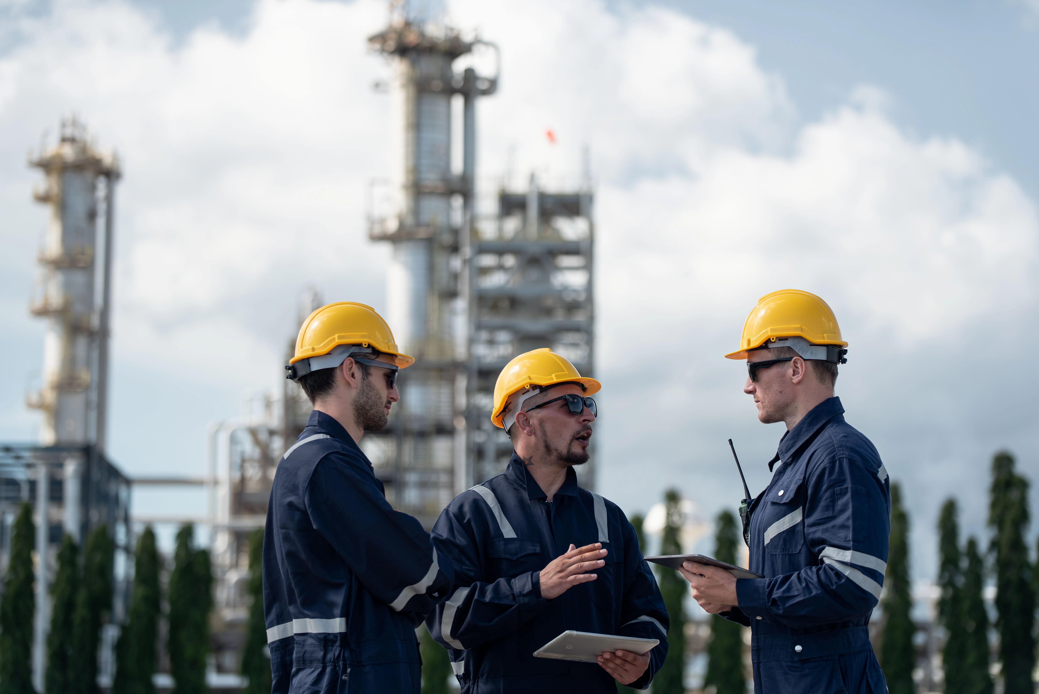
Engineering Roles in Clean Energy
Engineers design, build, and maintain climate solutions
Materials engineer
Research and improve use of new materials
Electrical engineer
Design safe and efficient energy flow
Civil engineer
Plan and design infrastructure
Lesson 12: Climate Hero Spotlight: Engineers
Notes:
Not all engineering is about structures – electrical engineers, materials engineers, and civil engineers are all critical to clean energy projects.

Slide 11
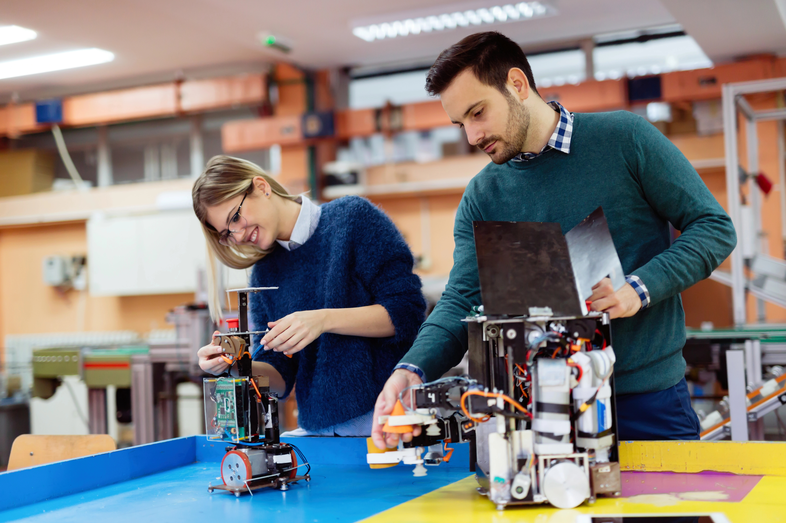
Engineering Roles in Clean Energy
Engineers design, build, and maintain climate solutions
Structural engineer
Ensures stability and safety of clean energy structures
Mechanical engineer
Design systems for clean energy technology
Environmental engineer
Evaluates and mitigates environmental impact of clean energy systems
Lesson 12: Climate Hero Spotlight: Engineers
Notes:
Engineering can take you in any direction if problem-solving and creativity are your passions.

Slide 12
Key Skills for Engineers
These core skills help engineers thrive in different industries:
Problem-solving
Mathematics
Project management
Software literacy
Communication
Lesson 12: Climate Hero Spotlight: Engineers
Notes:
Engineering skills are highly transferable across different fields or disciplines. As a result, engineers can easily switch fields or collaborate on projects that might be outside their usual area of expertise.
Depending on what specific type of engineering one goes into, there are many skills you might need, but these are the top five skill sets that are shared across the board:
Problem-solving. Critical thinking and innovative approaches apply to all engineering fields.
Mathematics. This is essential for design, analysis, and modeling in every branch of engineering.
Project management. This involves coordinating timelines, budgets, and teams.
Software literacy. Engineers use tools such as CAD, modeling, and simulation software. It’s helpful for an engineer to understand new software quickly and use different software tools on different aspects of the project.
Communication. Engineers need to explain complex ideas and collaborate with cross-functional teams.

Slide 13
Engineering Skills and Interests
You might enjoy engineering if you
are curious, creative, and persistent about problem-solving
are skilled at simplifying and communicating complex topics
enjoy math and sciences, such as physics, chemistry, biology, geology, or computer science
plan to pursue at least a bachelor’s or undergraduate degree.
Lesson 12: Climate Hero Spotlight: Engineers
Notes:
Most engineering roles do require an undergraduate degree.
Many schools will separate engineering programs based on the specific type of science behind them, but not all.
You can pursue advanced degrees in engineering and advanced certifications or licensing.
Some, but not all engineering roles require further licensing specific to the branch of engineering you’re pursuing.

Slide 14
Similar-but-Different
Roles similar to engineering include
engineering technicians
scientists.
Lesson 12: Climate Hero Spotlight: Engineers
Notes:
A couple of roles are similar to engineers but not quite the same.
Engineering technicians work closely with engineers but are often more hands-on than computer-based.
Scientists start by asking a question.
These roles involve conducting background research, formulating a hypothesis, conducting an experiment to test that hypothesis, analyzing the data, and documenting and communicating their results.

Slide 15
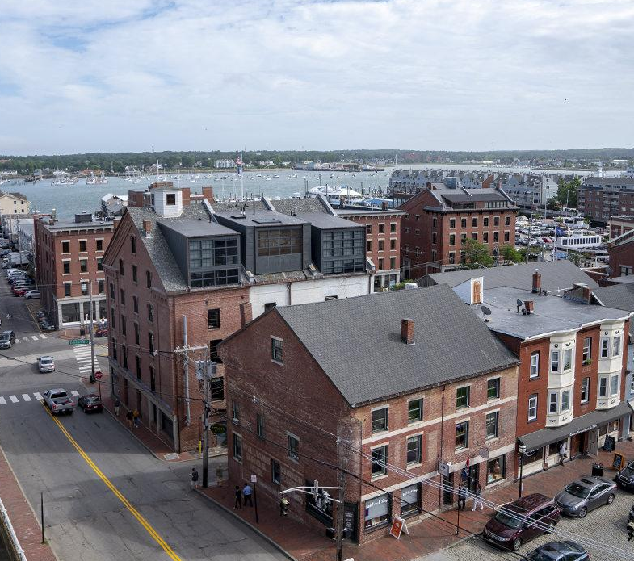
Today’s Group Activity
Engineering Feasibility Study in Sunnyville
Sunnyville, MA, is a small town that wants to ensure its community solar system operates efficiently and is eager to explore potential upgrades or improvements. The town has hired you—a team of engineers—to conduct a feasibility study and make recommendations!
Lesson 12: Climate Hero Spotlight: Engineers
Notes:
Activity objective: Allow students to use the engineering design process to evaluate and improve a real-world system and analyze data to identify challenges and opportunities for clean energy systems. Students will be able to present recommendations balancing feasibility, community needs, and sustainability goals.
Background: In small groups, students will act as a team of engineers hired by Sunnyville to conduct a feasibility study on the town’s existing solar and storage system. Sunnyville wants to ensure its systems are operating efficiently and is seeking recommendations for upgrades or improvements. Using the provided data and a design thinking process, students will analyze the current system, identify potential issues, and propose realistic solutions to optimize performance.
Instructions
Divide students into groups of an appropriate size for collaborative work and direct them to their worksheets, which will guide them through the activity.
In these groups, students will review the provided data about Sunnyville’s existing clean energy systems, including solar panels and battery storage. Data includes:
Energy output vs demand
Maintenance and operational costs
Community energy goals
Environmental factors like sunlight or grid reliability
Groups will identify areas where the system is underperforming or could be improved.
Groups will follow a guided design thinking process to prioritize and recommend upgrades or expansions they believe will significantly impact Sunnyville.
Groups will present their recommendations to the rest of the class, and together, we will decide which solutions best align with the town’s goals.

Slide 16
Presentations
Which recommendation best aligns with the town’s goals?
Optimize energy efficiency
Improve reliability
Reduce maintenance costs
Engineering Feasibility Study in Sunnyville
Lesson 12: Climate Hero Spotlight: Engineers
Notes:
Presentations and debrief
Invite each group to present their recommendation to the class, including:
The current system’s issues or inefficiencies
The team’s proposed upgrade(s) or solution(s)
A brief explanation of why their recommendation aligns with Sunnyville’s needs and goals
After all the presentations, ask the class to compare the recommendations. Hold a simple vote or discussion to decide which recommendation the class (or “town council”) would like to implement.
If there’s no clear winner, encourage students to reflect on how engineers must balance multiple factors when designing solutions. There often isn’t a single obvious best way forward.
Additional questions for debriefing (as needed)
What was the biggest challenge in evaluating Sunnyville’s clean energy systems?
How did your team balance technical feasibility with community needs and goals?
What did you learn about the importance of optimization and problem-solving in engineering?

Slide 17
Key Points
Engineers drive innovation in clean energy.
There are a variety of engineering roles involved in finding climate solutions.
Engineers require a wide range of skills and a problem-solving mindset.
Engineers have a huge impact on sustainable development.
Lesson 12: Climate Hero Spotlight: Engineers
Notes:
Engineers are crucial in designing and implementing clean energy solutions, from renewable energy systems to energy-efficient buildings.
Different types of engineers contribute to the clean energy sector, including environmental, mechanical, electrical, and civil engineers. Each role requires specialized skills to tackle different climate challenges.
Engineering careers in clean energy require strong problem-solving abilities, technical skills, and an innovative mindset to develop sustainable technologies.
Engineers help to build a sustainable future by creating systems and infrastructure that reduce emissions, improve efficiency, and support environmental resilience.
There are various pathways to becoming an engineer, including higher education, technical skills, and real-world engineering applications in clean energy. This is an excellent path for students who love math and science to explore.

Slide 18
Before You Go
What can we learn from how engineers approach problem-solving?
What is one question you still have about how engineers support climate solutions?
What interests you about becoming an engineer?
Closing Activity
Lesson 12: Climate Hero Spotlight: Engineers
Notes:
Give students two minutes to reflect on these questions in their worksheet/career guide.
Invite students to share their answers to one of the questions aloud.

Slide 19
Engineers play a critical professional role in Massachusetts’s Climate Solution Goals.
Lesson 10: Evaluating a Career in Clean Energy and Climate-Tech
|
19

