Slide 1
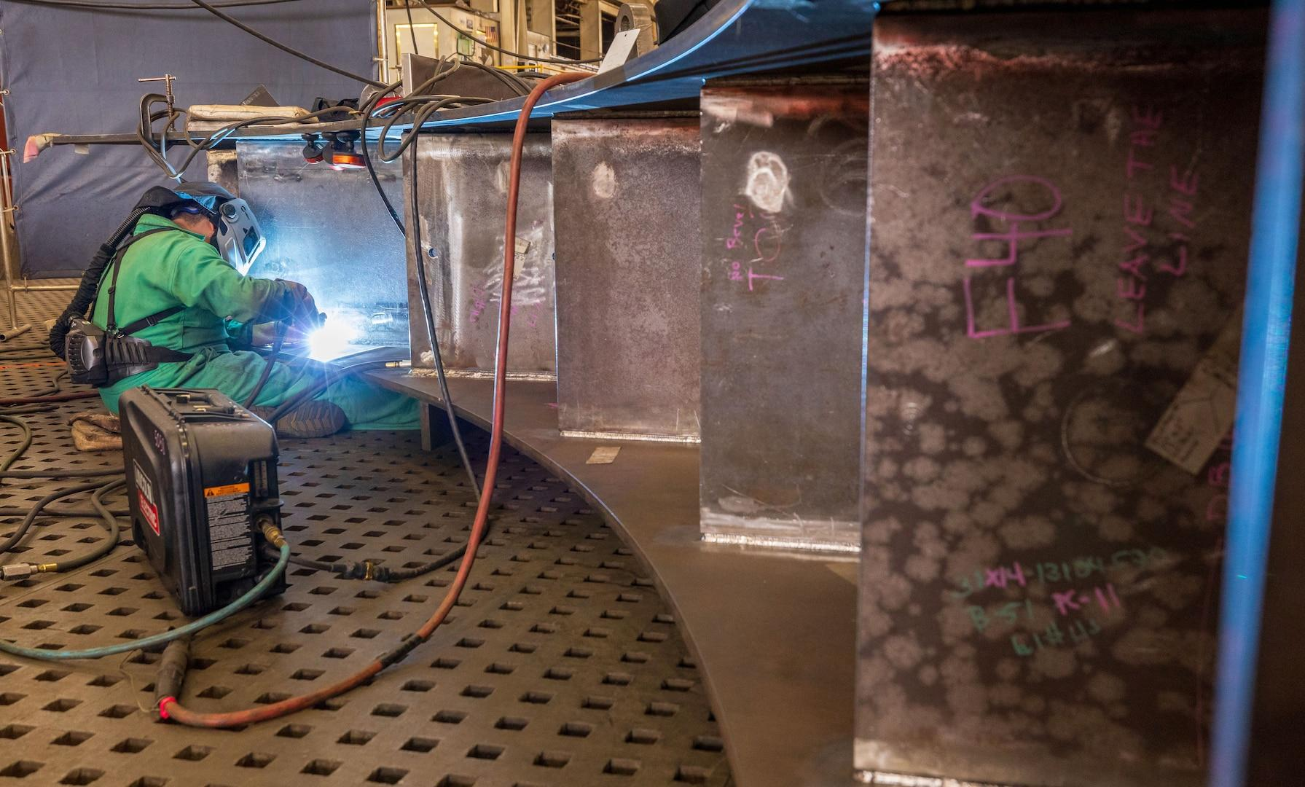
Massachusetts Climate Careers: Powering the Future
Climate Hero Spotlight:
Electricians
Notes:
Introduce the importance of electricians in making clean energy solutions possible.
Today’s lesson will highlight how electricians reduce carbon emissions and support climate resilience.

Slide 2
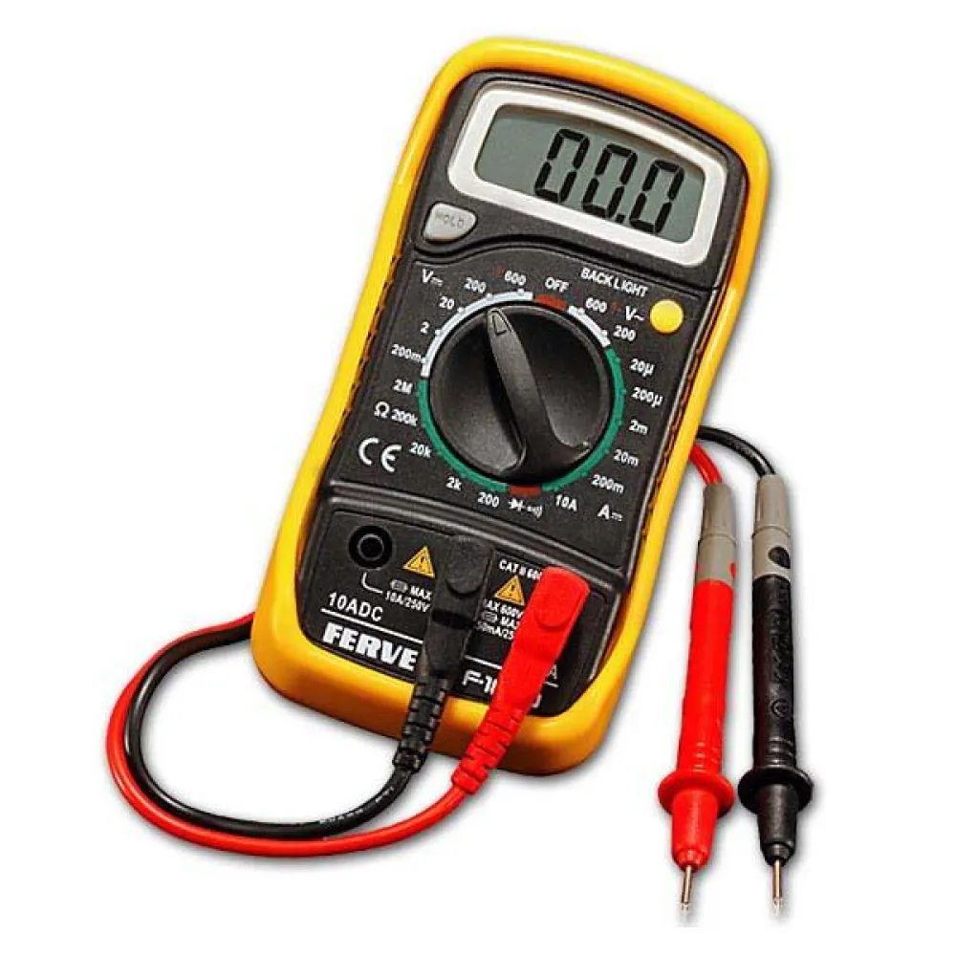
Opening Activity
What is in an electrician’s toolbox?
Multimeter:
Measures electrical properties, such as voltage, current, and resistance
Essential for troubleshooting and safety
Lesson 11: Climate Hero Spotlight - Electricians
Notes:
Activity objective: Let students learn about several tools of the trade. Electricians have some fun gadgets, so let's look at some of them!
Show the slide, and DO NOT CLICK to show the text so that students only see the image.
Background: Today’s lesson is about electricians. Before getting into the details of what they do, this is a chance to see if students can recognize some of the essential tools in their toolkit.
Instructions
Show the images on screen one at a time. Do not click a second time to reveal the answer until you are ready to do so.
Invite students to call out if they know what this image is and what they think it’s used for. Encourage students to apply what they have learned and use their imaginations.
After a few guesses, click a second time to reveal the answer.
Tools
Multimeter (pronounced muhl-TI-muh-ter): This is a tool that electricians use to measure electrical properties. It is used to diagnose electrical issues and confirm that circuits function correctly.
Wire strippers: These are not just pliers, but specifically wire strippers or wire stripping pliers. Electricians use them to remove the insulation coating wires without cutting the wire. Wires must be exposed carefully to make secure electrical connections, so these are essential.
Conduit bender: Electricians often need to bend pipes or tubing to house electrical wires, and this is what they use to do that. Those tubes and pipes are called conduits, and they enable electricians to ensure that the electrical wires running through a building are traveling through safe areas and won’t be exposed to water, fire, or anything else that would be unsafe.
Circuit tester: Electricians use this to see if any electrical current is running through an outlet or a circuit. This lets them know that a circuit is safe for them to work on, and it will let them know afterward that the power has been restored and the current is running through a circuit again.

Slide 3
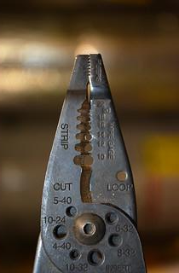
Opening Activity
What is in an electrician’s toolbox?
Wire strippers:
Strips the insulation from wires
Ensures clean, safe wire connections
Lesson 11: Climate Hero Spotlight - Electricians
Notes:
Instructions (same as the previous slide)
Show the images on screen one at a time. Do not click a second time to reveal the answer until you are ready to do so.
Invite students to call out if they know what this image is and what they think it’s used for. Encourage students to apply what they have learned and use their imaginations.
After a few guesses, click a second time to reveal the answer.
Tools
Multimeter (pronounced muhl-TI-muh-ter): This is a tool electricians use to measure electrical properties. It is used to diagnose electrical issues and confirm that circuits function correctly.
Wire strippers: These are not just pliers, but specifically wire strippers or wire stripping pliers. Electricians use them to remove the insulation coating wires without cutting the wire. Wires must be exposed carefully to make secure electrical connections, so these are essential.
Conduit bender: Electricians often need to bend pipes or tubing to house electrical wires, and this is what they use to do that. Those tubes and pipes are called conduits, and they enable electricians to ensure that the electrical wires running through a building are traveling through safe areas and won’t be exposed to water, fire, or anything else that would be unsafe.
Circuit tester: Electricians use this to see if any electrical current is running through an outlet or a circuit. This lets them know that a circuit is safe for them to work on, and it will let them know afterward that the power has been restored and the current is running through a circuit again.

Slide 4
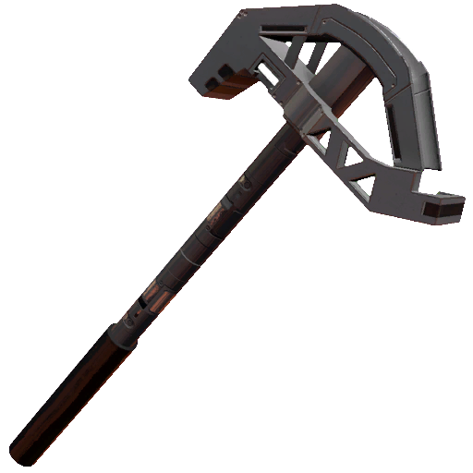
Opening Activity
What is in an electrician’s toolbox?
Conduit bender:
Bends metal and plastic conduit pipes and tubing to specific angles
Allows electricians to organize wires in safe, specific routes through buildings
Lesson 11: Climate Hero Spotlight - Electricians
Notes:
Instructions (same as the previous slide)
Show the images on screen one at a time. Do not click a second time to reveal the answer until you are ready to do so.
Invite students to call out if they know what this image is and what they think it’s used for. Encourage students to apply what they have learned and use their imaginations.
After a few guesses, click a second time to reveal the answer.
Tools
Multimeter (pronounced muhl-TI-muh-ter): This is a tool electricians use to measure electrical properties. It is used to diagnose electrical issues and confirm that circuits function correctly.
Wire strippers: These are not just pliers, but specifically, wire strippers or wire stripping pliers. Electricians use them to remove the insulation coating wires without cutting the wire. Wires must be exposed carefully to make secure electrical connections, so these are essential.
Conduit bender: Electricians often need to bend pipes or tubing to house electrical wires, and this is what they use to do that. Those tubes and pipes are called conduits, and they enable electricians to ensure that the electrical wires running through a building are traveling through safe areas and won’t be exposed to water, fire, or anything else that would be unsafe.
Circuit tester: Electricians use this to see if any electrical current is running through an outlet or a circuit. This lets them know that a circuit is safe for them to work on, and it will let them know afterward that the power has been restored and the current is running through a circuit again.

Slide 5
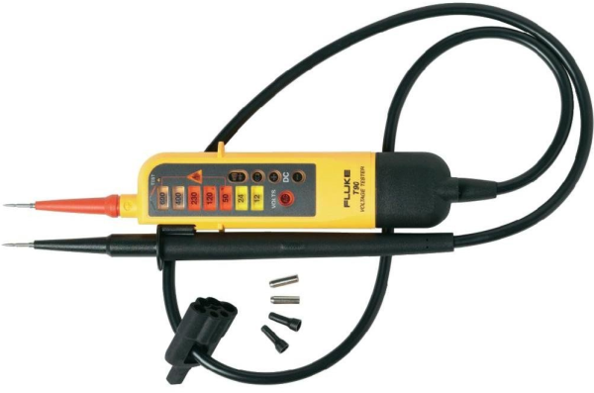
Opening Activity
What is in an electrician’s toolbox?
Circuit tester:
Used to check if any electrical power is running through an outlet or circuit
Essential precaution for safety
Lesson 11: Climate Hero Spotlight - Electricians
Notes:
Instructions (same as the previous slide)
Show the images on screen one at a time. Do not click a second time to reveal the answer until you are ready to do so.
Invite students to call out if they know what this image is and what they think it’s used for. Encourage students to apply what they have learned and use their imaginations.
After a few guesses, click a second time to reveal the answer.
Tools
Multimeter (pronounced muhl-TI-muh-ter): This is a tool electricians use to measure electrical properties. It is used to diagnose electrical issues and confirm that circuits function correctly.
Wire strippers: These are not just pliers, but specifically, wire strippers or wire stripping pliers. Electricians use them to remove the insulation coating wires without cutting the wire. Wires must be exposed carefully to make secure electrical connections, so these are essential.
Conduit bender: Electricians often need to bend pipes or tubing to house electrical wires, and this is what they use to do that. Those tubes and pipes are called conduits, and they enable electricians to ensure that the electrical wires running through a building are traveling through safe areas and won’t be exposed to water, fire, or anything else that would be unsafe.
Circuit tester: Electricians use this to see if any electrical current is running through an outlet or a circuit. This lets them know that a circuit is safe for them to work on, and it will let them know afterward that the power has been restored and the current is running through a circuit again.

Slide 6
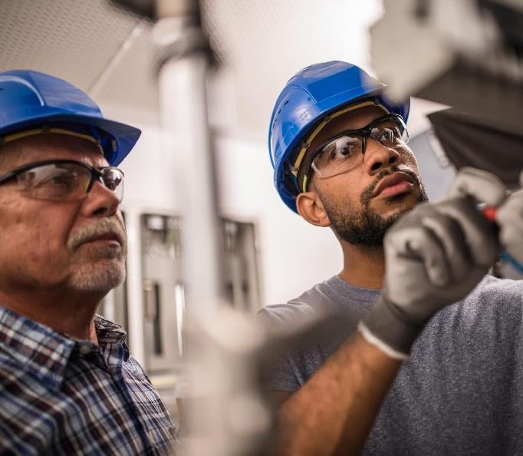
The Big Question and My Climate Goals
Climate Watch and Discussion
Electricians in Clean Energy Projects
Electrician Skills and Career Pathways
Electrician Project Planning Challenge
Takeaways and Closing Activity
Lesson 11: Climate Hero Spotlight - Electricians
Notes:
Review today’s activities.
Today, students will learn how electricians’ skills are essential to clean energy.
Students will learn more about some of the roles, skills, and career pathways for electricians—this is not a full list!

Slide 7
How do electricians play a critical role in implementing climate solutions?
Lesson 11: Climate Hero Spotlight - Electricians
|

Slide 8
When you complete this lesson, you’ll be able to:
Explore the range of clean energy projects that electricians work on.
Identify the skills, training, and experiences needed to become an electrician.
Discuss what aspects of a career as an electrician are aligned with your skills, interests, and desired work environment.
My Climate Goals
Lesson 11: Climate Hero Spotlight - Electricians
|
Notes:
Review today’s learning goals.
Encourage students to remember these goals as they go through today’s class.
Understanding the range of electricians’ work will help them see how different electrician careers contribute to climate solutions.

Slide 9
Electricians in Clean Energy
Solar panel installation and maintenance
EV charger installation
Wind turbine maintenance
Building electrification and upgrades
Energy efficiency retrofits
Lesson 11: Climate Hero Spotlight - Electricians
Notes:
Electricians install, maintain, and repair electrical power, communications, lighting, and control systems.
Invite students to call out how they think electricians contribute to each of these projects.
Connect this back to the big question: reinforce that these projects are critical to reducing carbon emissions and meeting clean energy goals.

Slide 10
Solar Energy
Residential, commercial, and utility-scale solar projects
Lesson 11: Climate Hero Spotlight - Electricians
|
Notes:
There are three types of solar projects: residential, commercial, and utility-scale.
Each project type differs in terms of scale and purpose.
Why would it be essential to have electricians who know how to work on small and large solar installations?
Project needs differ widely based on the size and location of the project, the electrical load, and the age and capacity of the grid components.

Slide 11
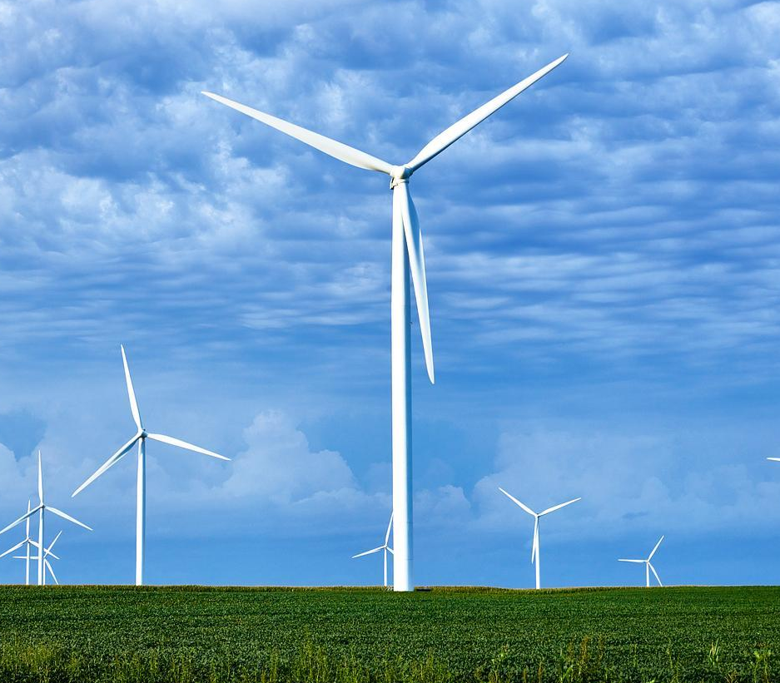
Wind Energy
Offshore wind farms
Utility-scale wind farms
Community wind projects
Lesson 11: Climate Hero Spotlight - Electricians
|
Notes:
There are also three types of wind energy projects: offshore wind farms, utility-scale wind farms, and community wind projects.
As with solar, each type varies in size, who it serves, and its overall purpose.
Each may require different skills from an electrician, especially in terms of the scale of the project or how it's connected to the grid.
For example, offshore and utility-scale projects are large and complex, while community projects are usually smaller and locally managed.
Sources for Further Reading:
International Renewable Energy Agency (IRENA)
U.S. Department of Energy (DOE)
National Renewable Energy Laboratory (NREL)

Slide 12
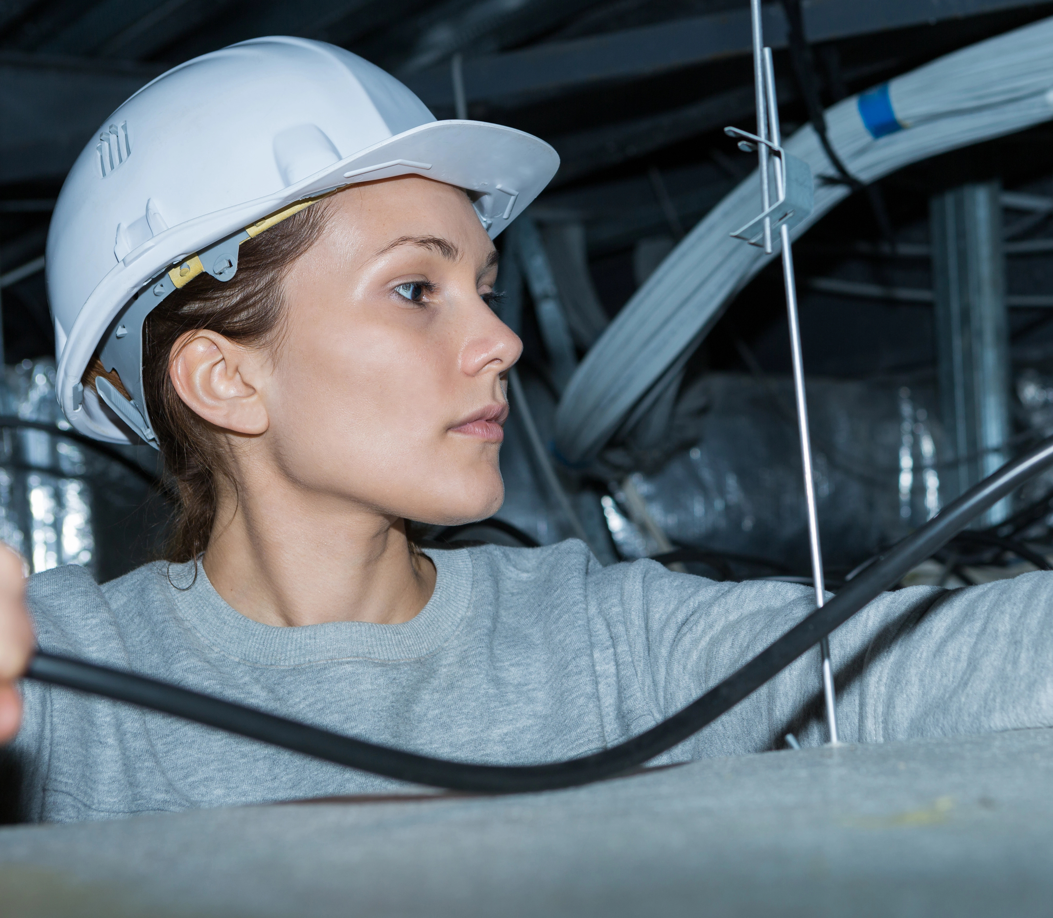
Building Electrification
Residential retrofits
Commercial upgrades
Building electrification
Lesson 11: Climate Hero Spotlight - Electricians
|
Notes:
Electrification of any building helps to replace fossil fuel-based systems with electric systems, which reduces emissions and makes buildings more energy efficient.
These types of projects, whether they are part of building new construction, updating specific systems, or retrofitting whole buildings, all require electricians and their expertise.
Sources for Further Reading:
International Renewable Energy Agency (IRENA)
U.S. Department of Energy (DOE)
National Renewable Energy Laboratory (NREL)

Slide 13
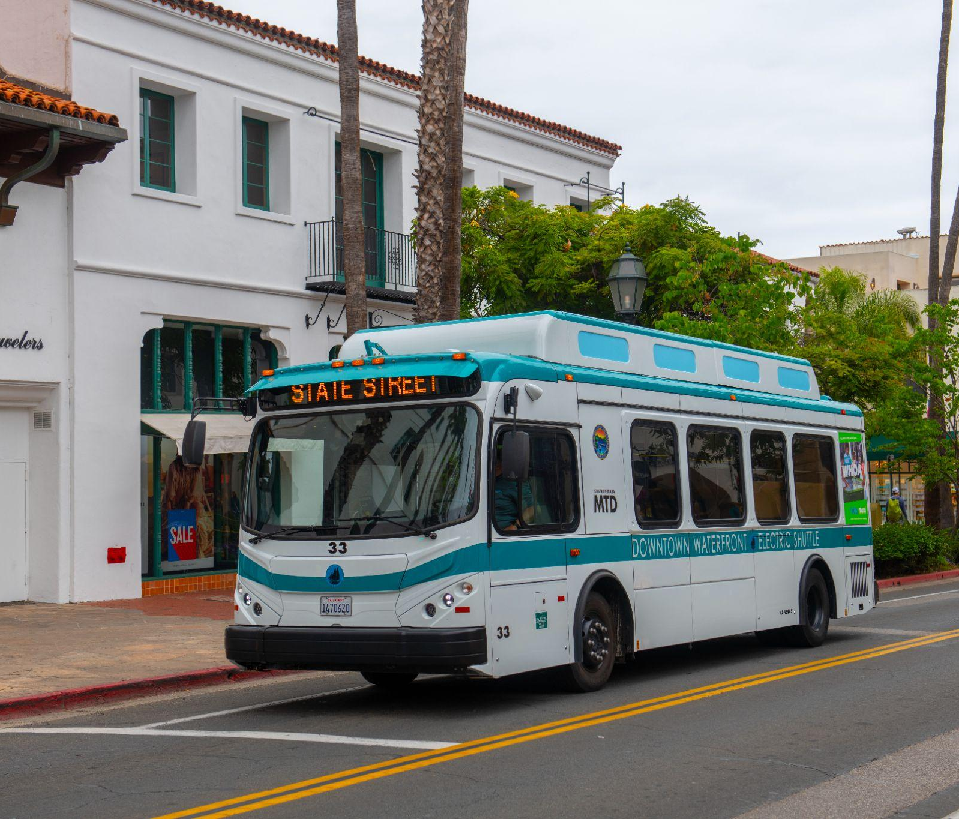
Transportation
Residential EV chargers
Commercial charging stations
Public EV infrastructure
Lesson 11: Climate Hero Spotlight - Electricians
|
Notes:
Transitioning to EVs requires electricians to install and maintain a charging station network, whether for personal vehicles or public transportation.
This includes charging stations people want in their homes or garages, charging stations owned by multifamily buildings or businesses, and charging stations in public spaces.
Projects like these, installed and operated in public areas, often have additional safety risks and precautions.
Specific steps are needed to keep the site and materials safe while installation is in progress, and precautions are taken to ensure that the site remains secure as it could be accessed or used by just about anyone.
Sources for Further Reading:
International Renewable Energy Agency (IRENA)
U.S. Department of Energy (DOE)
National Renewable Energy Laboratory (NREL)

Slide 14
Climate Watch: Video
Lesson 11: Climate Hero Spotlight - Electricians
|
Notes:
MassCEC Video coming by Spring 2025.
MassCEC video will be from a local electrical union featuring several apprentices and EV charging infrastructure.
Draft https://f.io/S3APNl23

Slide 15
What did the apprentices say they liked about beginning their career path with an apprenticeship?
What is one question you would ask an apprentice?
What do the apprentices highlight as benefits of training through the IBEW trade union?
Climate Watch Discussion
Lesson 1. Understanding and Combating Climate Change

Slide 16
International Brotherhood of Electrical Workers
Sheet Metal Workers International Association
International Association of Heat and Frost Insulators and Asbestos Workers
United Association of Journeymen and Apprentices of the Plumbing and Pipefitting Industry
International Union of Painters and Allied Trades
Laborers International Union
Clean Energy Workers’ Trade Unions
Lesson 1. Understanding and Combating Climate Change
Notes:
Electricians are one of the clean energy career paths that have a union. Many licensed trades, like electricians, pipefitters, plumbers, utility workers, carpenters, and others, can join unions. These are some of the unions that are common for trades and careers in clean energy:
For Electricians: International Brotherhood of Electrical Workers
HVAC: Sheet Metal Workers International Association
Weatherization: International Association of Heat and Frost Insulators and Asbestos Workers
Water heating and geothermal workers: United Association of Journeymen and Apprentices of the Plumbing and Pipefitting Industry
International Union of Painters and Allied Trades
Solar Technicians: Laborers International Union
This is not a complete list, but this gives you a good idea of what’s available.
The video shows that unions provide many worker benefits, including apprenticeships and training programs.
For many people, this makes it possible to achieve stable, high-paying jobs without taking on any college debt and—as you also saw in the video—even earning money while being trained.
Many unions offer extensive training opportunities across Massachusetts and the country.
Many unions also help establish what are known as prevailing wages across the state.
Prevailing wage laws in MA ensure that workers on public construction projects, such as building schools or roads, are paid fairly.
The “prevailing wage” is the state's standard pay rate for different jobs. It ensures workers earn good wages and fair competition between companies.

Slide 17
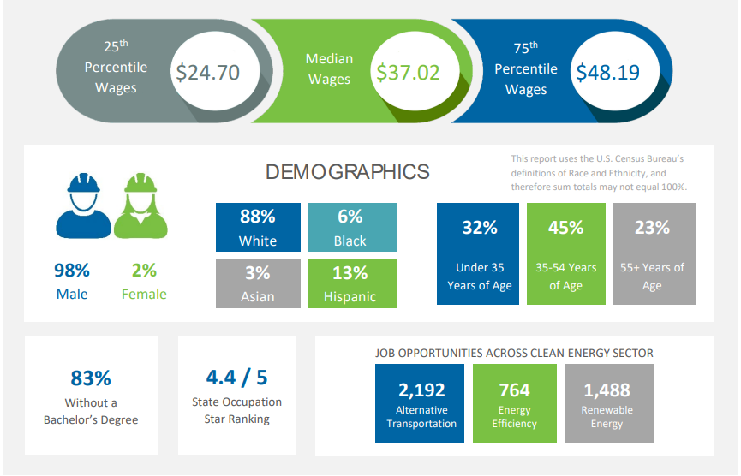
Prevailing wages up to $60/hour.
Lesson 11: Climate Hero Spotlight - Electricians
|
Notes:
This data is directly from the Massachusetts Clean Energy Workforce Needs Assessment.
Point out the wages at the top of the graphic, specifically the median wages for electricians in Massachusetts.
However, the prevailing base hourly wage for Electricians working in the Boston area is closer to $60/hour.
Electricians can also earn higher wages with additional specialized training and experience.
Point out that 83 percent of electricians do not have a bachelor’s degree, so this is a career path that doesn’t require a four-year college education.

Slide 18
Knowledge and Skills
Safety practices and protocols
Electrical installation and wiring
Troubleshooting and problem-solving
Familiarity with renewable energy systems
Lesson 11: Climate Hero Spotlight - Electricians
|
Notes:
Electricians are highly skilled technical experts with an essential skill set and knowledge base.
For example:
Installation of electrical equipment: Experience installing various electrical components, such as circuit breakers, transformers, outlets, switches, and lighting systems. Proficiency in setting up electrical panels and subpanels.
Maintenance and repair: Skills in maintaining and repairing existing electrical systems, ensuring they operate efficiently and safely—the ability to replace faulty components and perform regular inspections.
High-voltage work: Knowledge and skills to work with high-voltage systems, including safety protocols and specialized equipment.
Energy management systems: Understanding energy management and efficiency practices, including installing and maintaining energy-efficient lighting and HVAC systems.

Slide 19
Training Pathway
High school diploma or GED
Vocational training programs
Apprentice (work + school)
Journeyman (pass an exam)
Master electrician
Demand for electricians will have increased by 37 percent by 2030!
Lesson 11: Climate Hero Spotlight - Electricians
|
Notes:
Becoming an electrician requires completing a rigorous and specific training and certification process.
Like many trade roles, electricians are certified professionals, so most states have a certification and licensing process.
Once you become a certified electrician, you can maintain that certification through continuing education or training every few years.
The first step toward becoming an electrician is to complete your High School Diploma or GED.
Courses in mathematics, physics, and technical subjects are beneficial.
Vocational training programs:
Provide hands-on experience and technical knowledge specific to electrical work and renewable energy.
Programs typically last from several months to two years.
Apprenticeships to become a journeyman:
Require a high school diploma or GED
Require 8000 hours of training, which is usually four years but can be three to five depending on the program and specialty.
Provide hands-on training, learning directly from experienced professionals.
This is a great way to learn specialized skills if there is a specific area that you are most interested in.
Apprentices attend classes to learn the theoretical aspects of electrical work and renewable energy systems.
Technical schools offer electrician training programs that count toward the required hours for certification:
They offer comprehensive training in electrical technology, often including renewable energy modules.
Programs may lead to an associate degree or technical certification.
These certifications may include:
North American Board of Certified Energy Practitioners (NABCEP) for solar
Global Wind Organization (GWO)Basic Technical Training-Electrical for wind
Occupational Safety and Health Administration (OSHA) for safety
Manufacturer Certification, such as Tesla Certified Installer

Slide 20
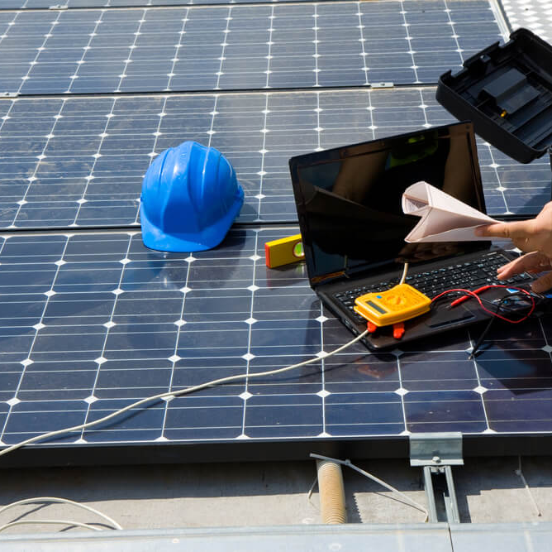
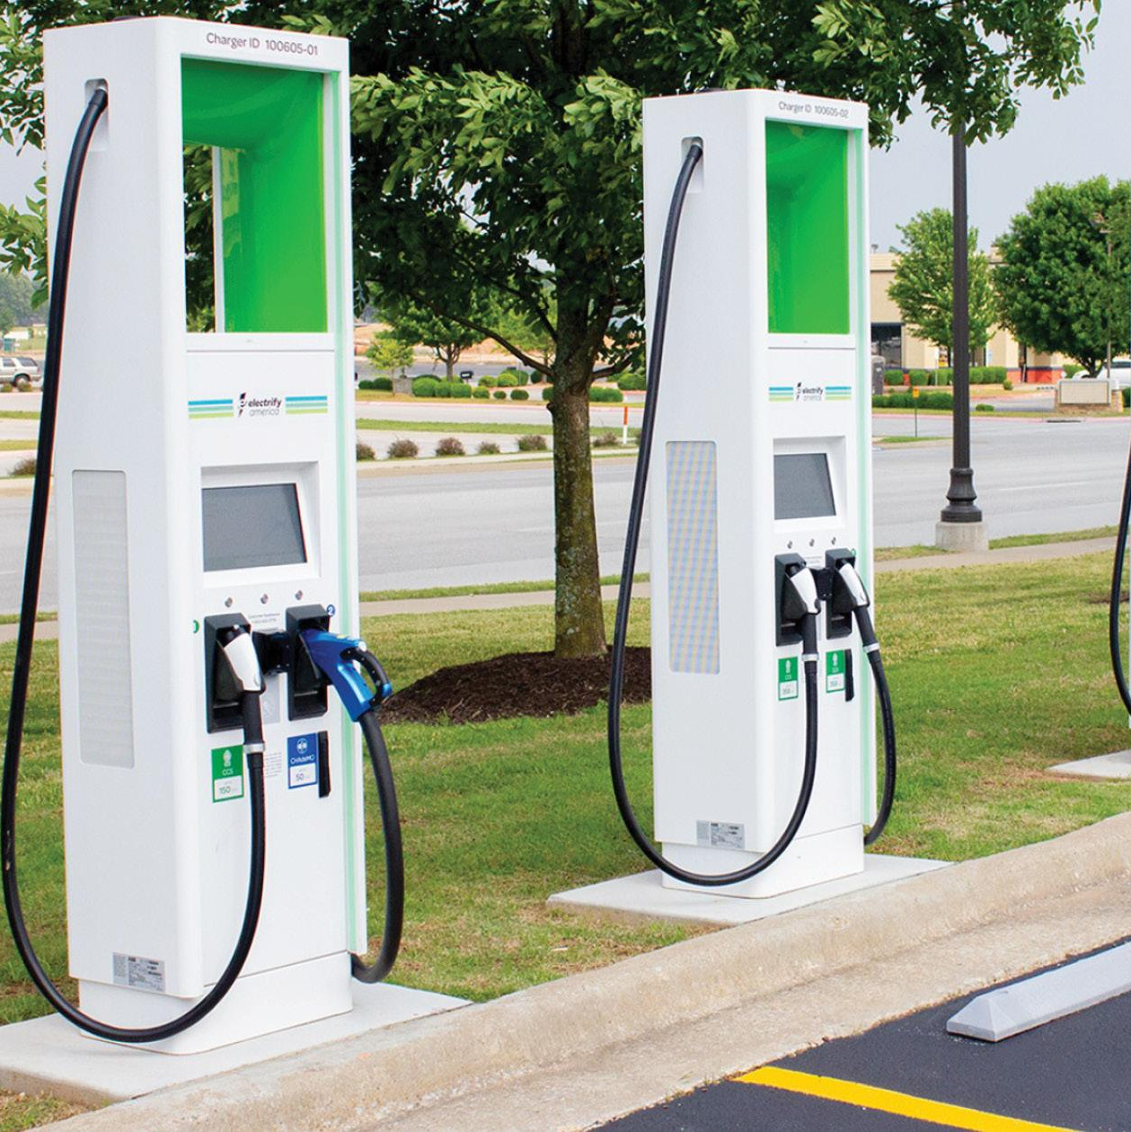
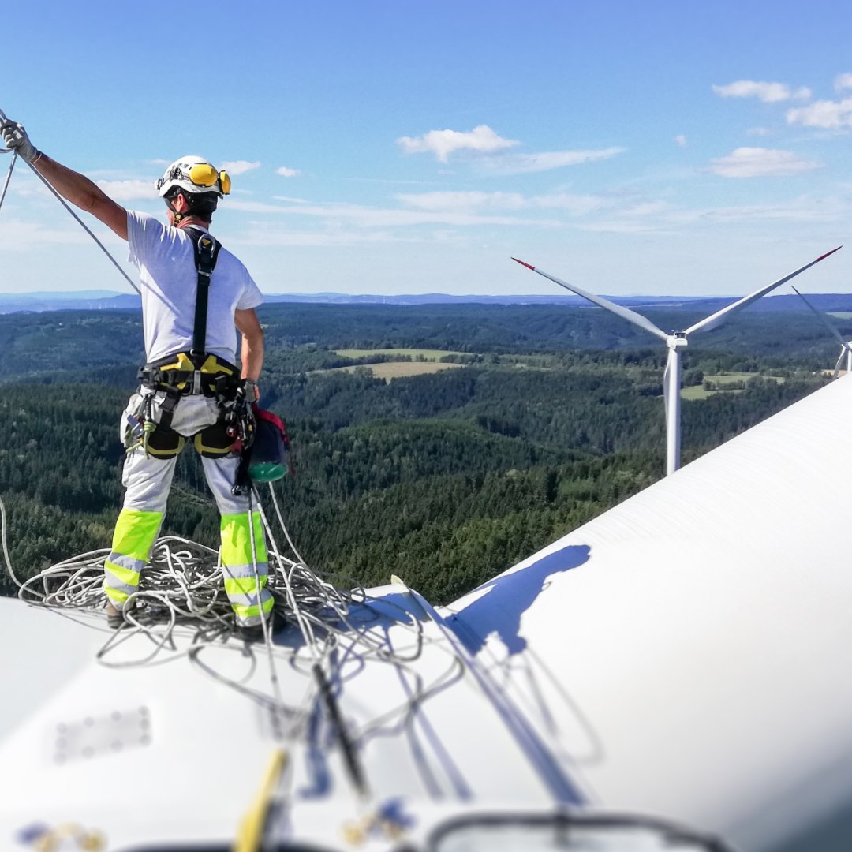
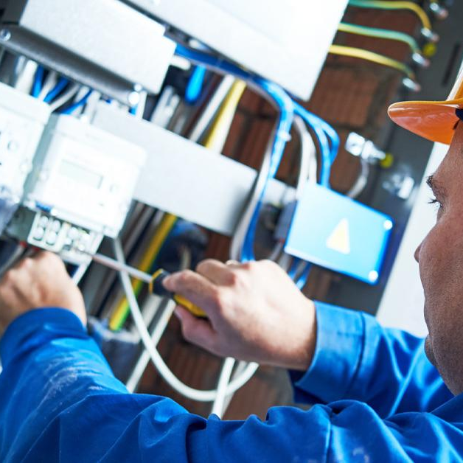
Today’s Group Activity
Electrician Project Planning Challenge
Solar
installation
EV charge
station setup
Wind turbine maintenance
Energy-efficient building retrofit
Lesson 11: Climate Hero Spotlight - Electricians
Notes:
Activity objective: Simulate electricians' real-world planning for clean energy projects. Students will better understand electricians' essential role in making sustainable energy projects safe and effective.
Group assignment projects for this activity
Solar panel installation
EV charging station setup
Wind turbine maintenance
Energy efficiency retrofit
Instructions
Divide students into groups; each group will work on a different project type (see above). If the class size allows for more than four groups, more than one group can work on each project plan. Direct students to their worksheets, which will guide them through the activity.
As a group, students should examine the details of their assigned project provided on their worksheets. Then, students should consider the practical steps of completing their project and discuss the specific tools they need and unique safety measures.
For example, Group 1 would consider roof suitability; Groups 2 and 4 would consider their projects' energy sources.
Students will have 12 minutes to plan their projects and make short (one-minute) presentations to the class.
Debrief Discussion
What did they learn about the planning involved for their project type?
Did this activity change how any of them viewed or felt about electricians?
Conclude by emphasizing that electricians are essential for the success and safety of clean energy projects and for Massachusetts to meet its clean energy targets.
Touch on some of the specializations in electrical work that have come up in these projects, all of which contribute to climate resilience.

Slide 21
Key Points
Electricians are essential to installing, maintaining, and upgrading systems necessary for the clean energy transition.
Electricians work in residential, commercial, and industrial settings.
To become an electrician, one must have problem-solving skills, technical expertise, and adaptability to new technologies.
The shift to clean energy creates a growing demand for electricians.
Lesson 11: Climate Hero Spotlight - Electricians

Slide 22
Before You Go
What challenges will we face if we don’t have enough electricians for clean energy projects?
How can we encourage more people to enter the electrician field?
How do electricians help to build climate resilience?
Closing Activity
Lesson 11: Climate Hero Spotlight - Electricians
|
Notes:
Achieving net zero emissions heavily depends on electrification, meaning electricians are essential to achieving our climate goals.
Encourage students to respond to one or more of these questions to wrap up the class.

Slide 23
Lesson 11: Climate Hero Spotlight - Electricians
|
Notes:
`

