Slide 1
Navigating the Future: Pathways to My Career in Clean Energy
Innovation and the Future
of Climate-Tech
Notes:
Today’s lesson will explore real-world examples of creative solutions to climate challenges.
Students should begin thinking about how technology shapes the future of clean energy.

Slide 2
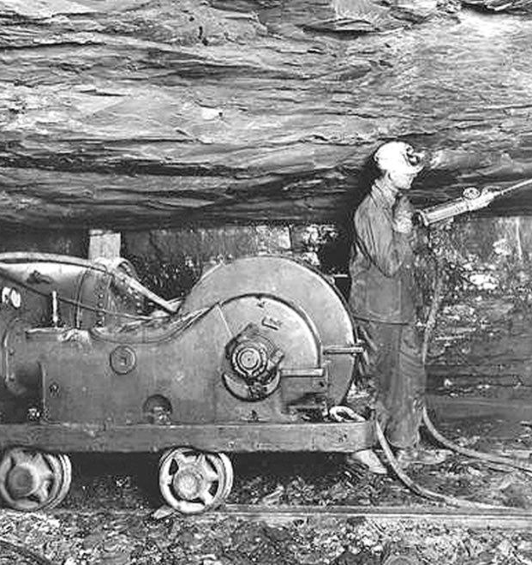
Opening Activity
Which energy innovation am I?
I was invented in 1712.
My original purpose was to pump water out of coal mines.
Today, you find me generating electricity in geothermal power plants.
steam engine
Notes:
Activity objective: Highlight how innovation drives progress and adaptability; emphasize that innovation extends beyond its original purpose.
ANIMATED - Wait to click to reveal the image as an additional clue. Then wait to reveal the answer.
Background: Often, great innovations come from applying existing ideas in new ways. Many technologies we use today may have first been invented for something entirely different. Give students the chance to identify three of these essential technological innovations based on their origins.
Instructions:
Read the clues for the first innovation and ask students to call out their guesses.
Click to reveal the image as the final clue.
After students share their final guesses and explanations for their thinking, click again to reveal the answer.
Answer 1 of 3: The steam engine
The steam engine was one of the earliest machines to convert energy to mechanical power.
Over time, it has been used to power factories, trains, ships, etc.
The steam engine made the Industrial Revolution possible
The turbine design is still used today in modern steam-based power plants, including biomass and geothermal energy plants, which are types of renewable energy power plant.

Slide 3
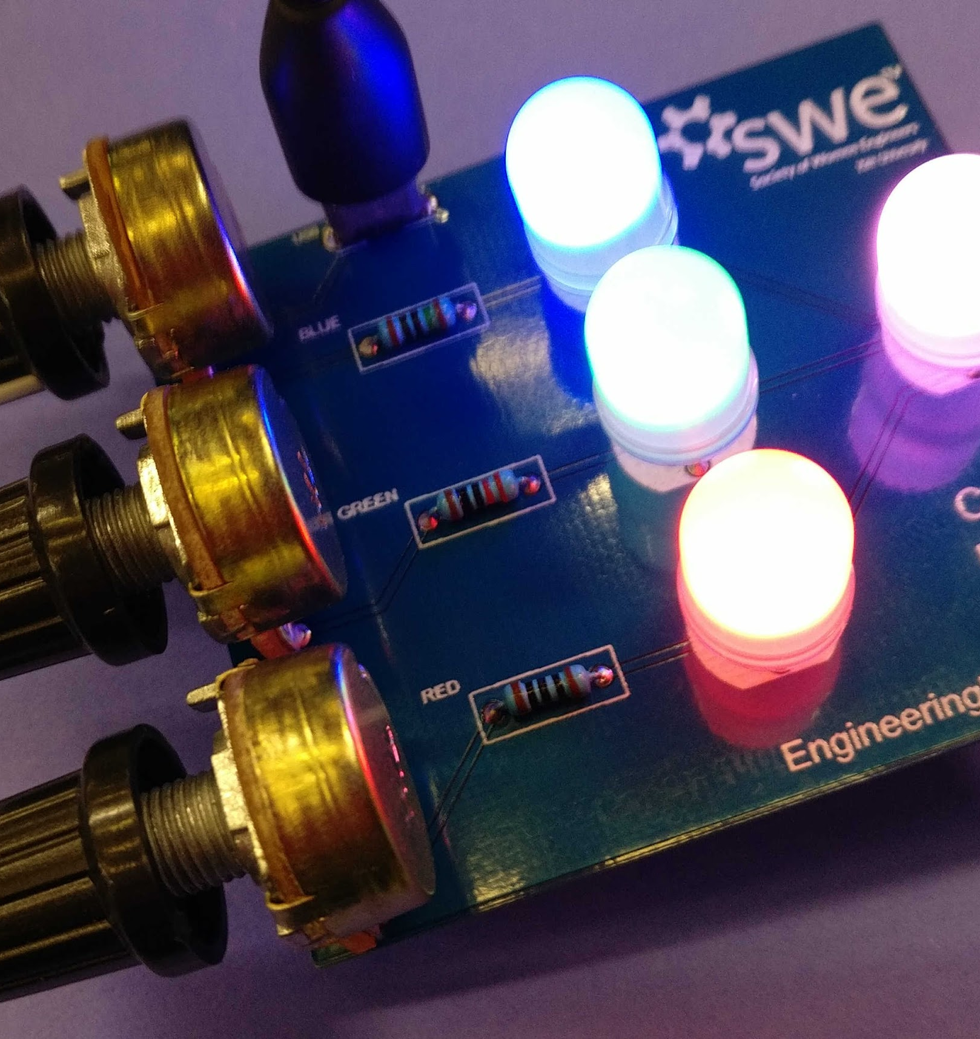
Opening Activity
Which energy innovation am I?
I was invented in 1962.
I was first used as a low-power indicator light for electronic devices.
Today, you will find me illuminating energy-efficient homes, schools, and buildings worldwide.
light-emitting diode (LED)
Notes:
Read the clues for the second innovation and ask students to call out their guesses.
Click to reveal image as final clue.
After students share their guesses and explanations for their thinking, click again to reveal the answer.
Answer 2 of 3: The LED or light-emitting diode
LEDs were invented to be an indicator light for electronics, such as TVs and radios; they were energy-efficient and didn’t use much power, so they could be incorporated into a device’s design without requiring lots of additional power.
Today, LEDs are used everywhere. We use LED light bulbs, grow lights in greenhouses, and computer monitors or TV screens.
Because they are more energy-efficient than traditional light bulbs, they play an important part in lowering our electricity use in homes and buildings.

Slide 4
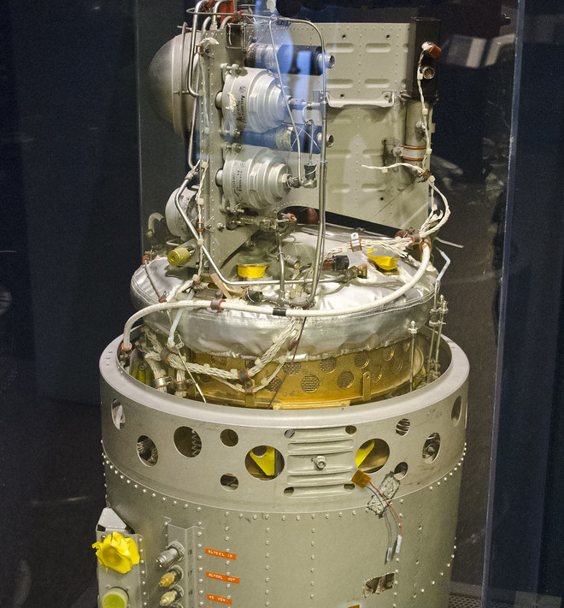
Opening Activity
Which energy innovation am I?
I was invented in 1838 but gained fame in the 1960s during the space race.
I was used to generate clean electricity and water for astronauts on space missions.
Today, you can find me powering zero-emission vehicles and providing backup power for critical infrastrastructure.
fuel cell
Notes:
Read the clues for the third innovation and ask students to call out their guesses.
Click to reveal image as final clue.
After students share several guesses and their explanations for their thinking, click again to reveal the answer.
Answer 3 of 3: The fuel cell (specifically, the proton exchange membrane (PEM) fuel cell
The basic concept was developed in the 19th century, but practical fuel cells weren’t invented until NASA needed a reliable source of clean electricity and water in space.
PEM fuel cells were used by astronauts on spacecrafts like Gemini and Apollo.
These fuel cells worked in space because they produced only water and electricity as by products, with no other emissions.
Today, these fuel cells are used in hydrogen-powered vehicles, such as fuel cell electric cars, buses, and even trains.
They are also used to provide reliable backup power for data centers, hospitals, and emergency services.
These technologies were created for a specific use but have been adapted for other applications over time, including clean energy uses.

Slide 5
The Big Question and My Climate Goals
Climate Watch and Discussion
Innovating Climate Solutions
Innovation Impact Map
Takeaways and Closing
Notes:
Today’s lesson is about connecting innovative thinking with real-world impact.

Slide 6
How do innovation and creative thinking help us reach our climate goals in Massachusetts?
Notes:
After today’s lesson, students should be able to discuss how different types of innovations can drive cleaner, more sustainable communities across Massachusetts and elsewhere.
Keep this question in mind throughout today’s lesson.

Slide 7
When you complete this lesson, you’ll be able to:
Identify examples of how innovation has advanced Massachusetts’s climate solutions.
Identify and describe innovations that will accelerate the creation of new solutions to climate change.
Describe how research and design contribute to innovation in climate solutions.
My Climate Goals
Lesson 1. Understanding and Combating Climate Change

Slide 8
Climate Watch: Video
Notes:
Video coming by Spring 2025.
There are two videos: two engineers at two different companies.
Adept Materials in Somerville has developed a proprietary two-layer system that endows materials with advanced moisture management capabilities. It can be used in high-performance buildings.
Sublime Systems makes zero-carbon cement. “It's been said that if the cement industry were a country, it would be the world's third or fourth-largest emitter of carbon dioxide (CO2).” (World Economic Forum 2024)

Slide 9
Climate Watch: Video
Notes:
Video coming by Spring 2025.
There are two videos: two engineers at two different companies.
Adept Materials in Somerville has developed a proprietary two-layer system that endows materials with advanced moisture management capabilities. It can be used in high-performance buildings.
Sublime Systems makes zero-carbon cement. “It's been said that if the cement industry were a country, it would be the world's third or fourth-largest emitter of carbon dioxide (CO2).” (World Economic Forum 2024)

Slide 10
Share what you learned from the video and listen to your classmates’ perspectives. Here are a few thoughts to get you started.
What does DQ like about her career?
What does the specialized paint do?
Climate Watch Discussion

Slide 11
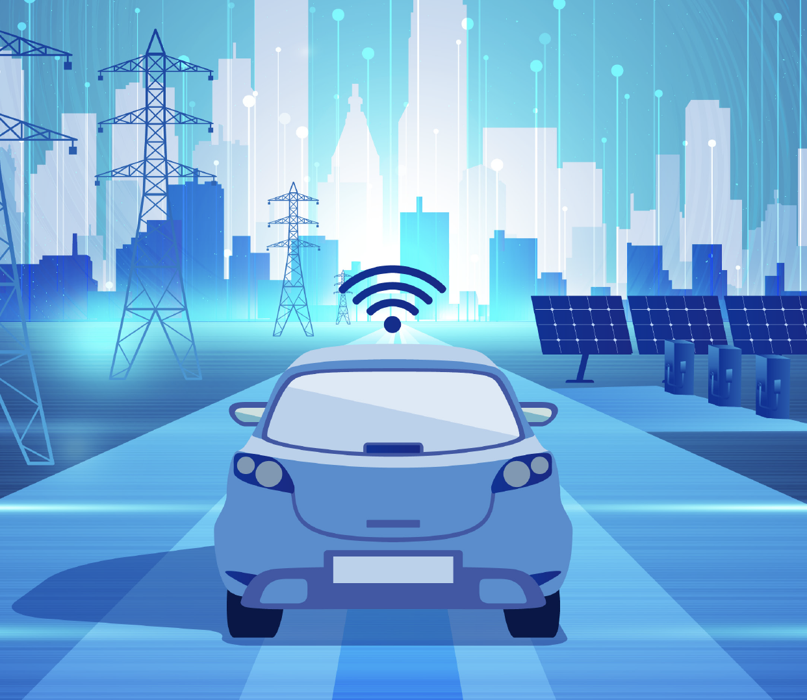
Vehicle-to-Grid (V2G) Technology
Electric vehicles (EVs) can send electricity back to the power grid, acting as mobile batteries.
Balance energy supply and demand
Provides backup power
Reduces reliance on fossil fuels
Notes:
V2G technology allows EVs to store energy and send it back to the grid.
This can help stabilize the electricity supply.
Imagine if your car could power your home during a blackout!
In Massachusetts, V2G technology can support renewable energy because EVs can store excess solar or wind power.

Slide 12
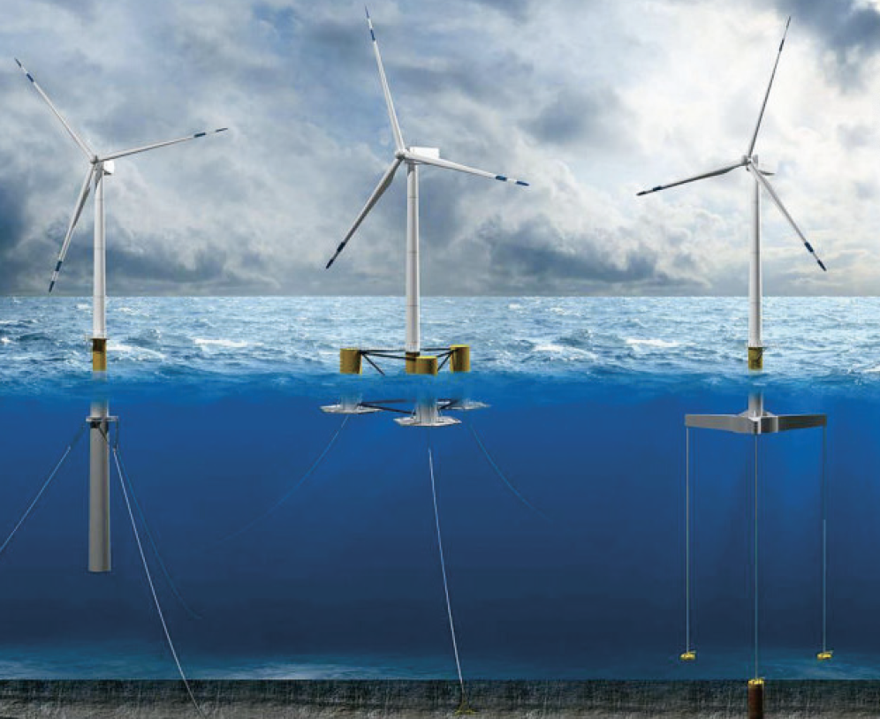
Floating Wind Turbines
Wind turbines on floating platforms anchored to the seabed
can be installed in deeper waters where winds are stronger
can expand offshore wind capabilities and expand clean energy production.
Notes:
About two-thirds of the United States’ offshore wind potential exists over bodies of water too deep for “fixed-bottom” wind turbine foundations secured to the sea floor.
Harnessing power over waters hundreds to thousands of feet deep requires floating offshore wind technology—turbines mounted to a floating foundation or platform moored to the seabed.
Floating offshore wind turbines can be placed in deep waters with more wind.
Because there is more wind, these turbines create more energy than traditional wind turbines on land or closer to shore.
This also allows them to be placed in more locations because they have much more space.
In Massachusetts, offshore wind power projects like Vineyard Wind use fixed-bottom foundations. The development of floating foundation wind turbines will open up additional areas for wind farm development, creating new options for offshore wind farms.

Slide 13
Low-Carbon Steel and Cement
New manufacturing methods reduce CO₂ emissions during production.
Cement and steel are essential for nearly all construction and infrastructure projects.
Traditional materials are significant sources of GHG.
Notes:
Cement and steel are essential for building almost anything—roads, buildings, bridges.
Their production generates a lot of carbon emissions.
New processes can make these necessary materials cleaner and more sustainable.
Massachusetts companies, like Sublime Systems, are pioneering these materials, helping to lower construction's carbon footprint.

Slide 14
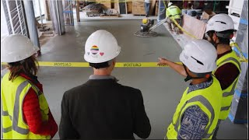
Low-Carbon Steel and Cement
Notes:
This slide and video are hidden; they can be used if needed for additional content. This video relates to the Low-Carbon Steel and Cement discussed on the previous slide.
Massachusetts-based Sublime Systems has developed a low-carbon alternative to typical building cement that reduces kiln emissions by 50 percent without changing the cement’s properties or chemistry.

Slide 15
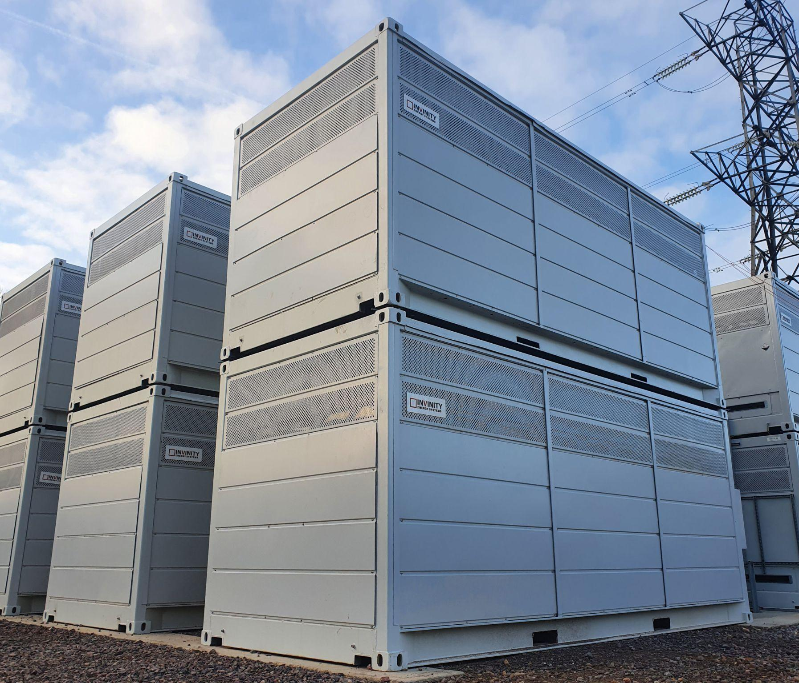
Long-Duration Batteries
Store electricity for several hours to days
Maintain a steady supply of renewable energy
Ensure a reliable energy supply, making renewables more practical
Courtesy of Invinity Energy Systems

Slide 16
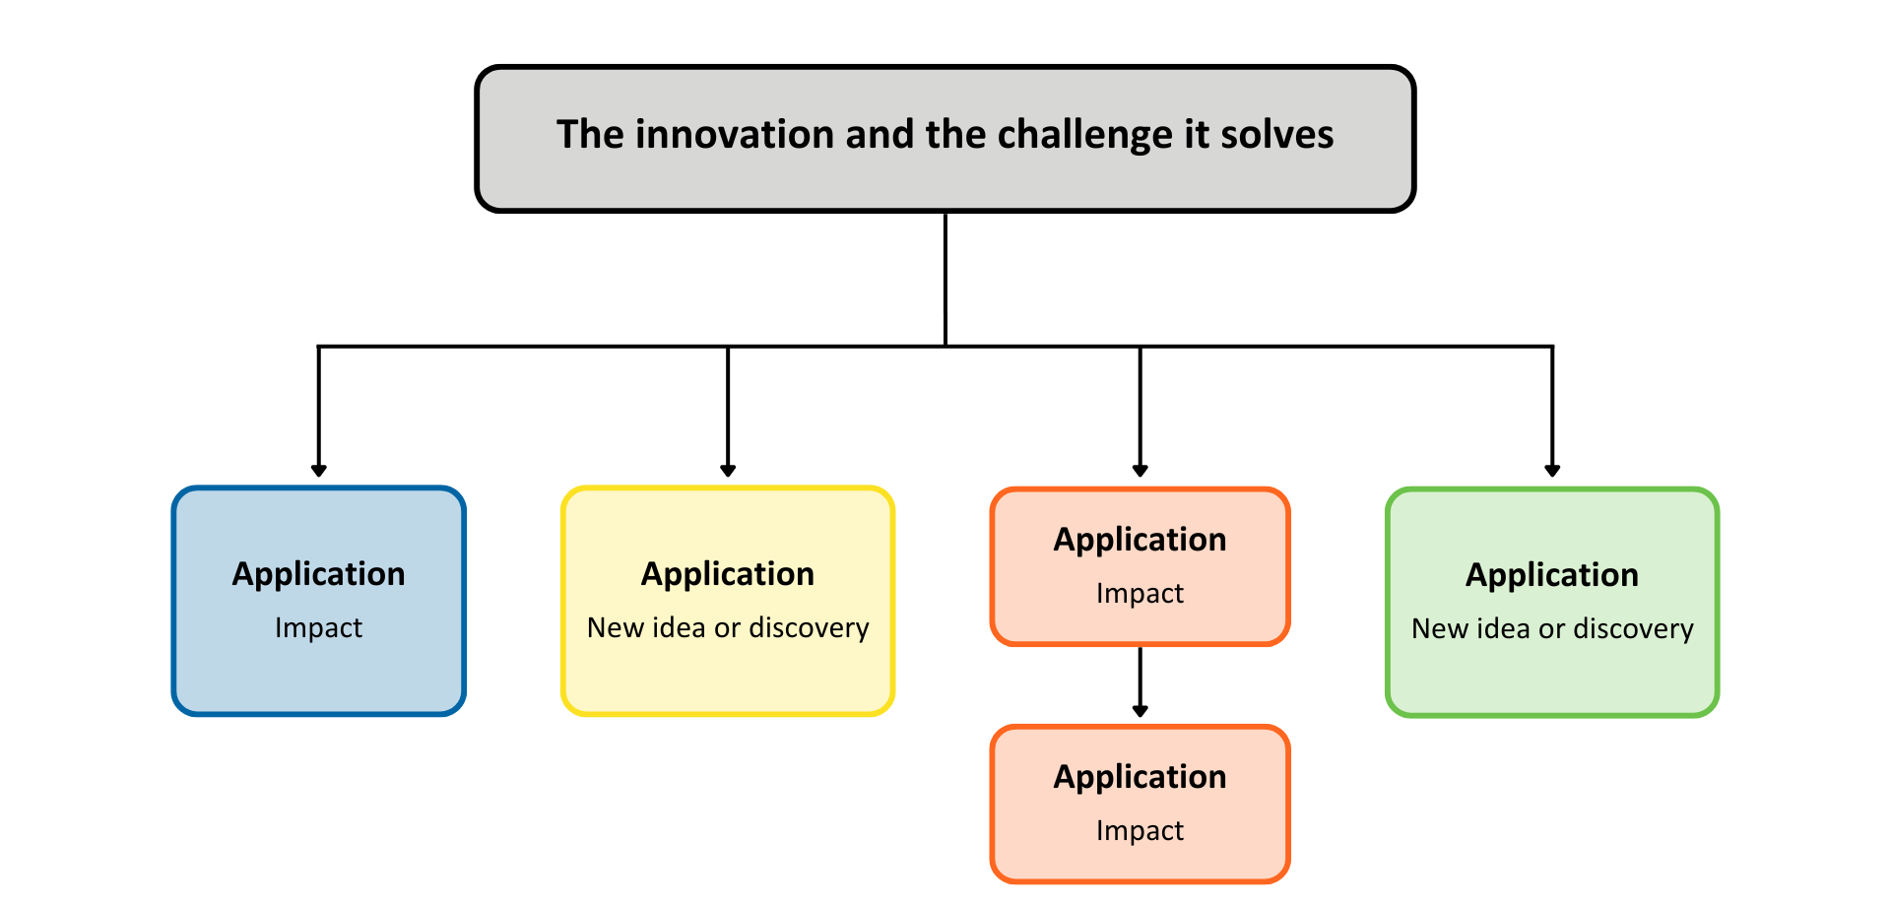
Today’s Group Activity
Innovation Impact Map
Notes:
Activity objective: Consider how climate innovations relate to challenges and questions and their impact on communities.
Students will work in groups to create an “Innovation Impact Map” or tree.
We start with a question or a climate challenge. Students will select one challenge to focus on.
We then explore the innovation that addresses that challenge, followed by the impacts of that innovation, including benefits, challenges, and further innovations or technologies.
Instructions:
Divide students into groups. The worksheets provide guidance for completing this activity. Student groups should be small since this is a creative collaboration activity.
In their groups, students will:
Identify the question or climate challenge they want to focus on as a group. They should be prepared to share their innovation and three ways it will impact their community with the rest of the class.
Come up with an innovation to address that challenge. Students may select an existing innovation discussed or create something of their own!
Fill in the branches with the many ways this innovation could affect the community when implemented. Include benefits, but also consider things that could be disruptive or difficult. Also, include ideas about other ways this innovation could be applied, like with the steam engine or LED bulbs.
Groups will have 12 minutes to work before presenting their maps/trees to the class. They will focus on two to three impacts they found most exciting or unexpected.
Debrief discussion:
Invite other groups to respond to one another’s presentations with ideas for how the innovations could be combined with different technologies to have a more significant impact.
Even small ideas can have a significant impact.
Climate innovations are about finding solutions and discovering new ways to make our communities healthier and cleaner.

Slide 17
Innovation drives clean energy progress.
Historical technologies can have modern applications.
Energy innovations create diverse career paths.
Adaptability and curiosity fuel innovation.
Notes:
Emphasize the role of innovation; highlight how historical and modern technologies contribute to today’s clean energy solutions.
Highlight the variety of career opportunities these innovations create and encourage students to think about the skills and interests that align with these roles.
Encourage curiosity. Remind students that being open to learning and exploring new ideas is essential in clean energy fields, where technology is continually evolving.
The energy field thrives on problem-solving and curiosity with constant advancements that respond to environmental needs and challenges.

Slide 18
What is one climate-related problem or question that needs a solution?
What is one climate-related innovation that has had a significant impact on Massachusetts’s energy transition?
Closing Activity
Notes:
Every innovation begins with someone thinking, “There’s got to be a better way to do this.”
Invite students to think of one climate-related problem or question that needs a solution.
They do not need to have any idea what that solution could be!
Students should write it down on an index card (or perhaps in their worksheets).
Students should consider their community or Massachusetts as a whole.
Invite a few students to share their questions or challenges aloud.

Slide 19
Innovating climate solutions is an essential step in meeting Massachusetts’s clean energy and efficiency goals.

