Slide 1
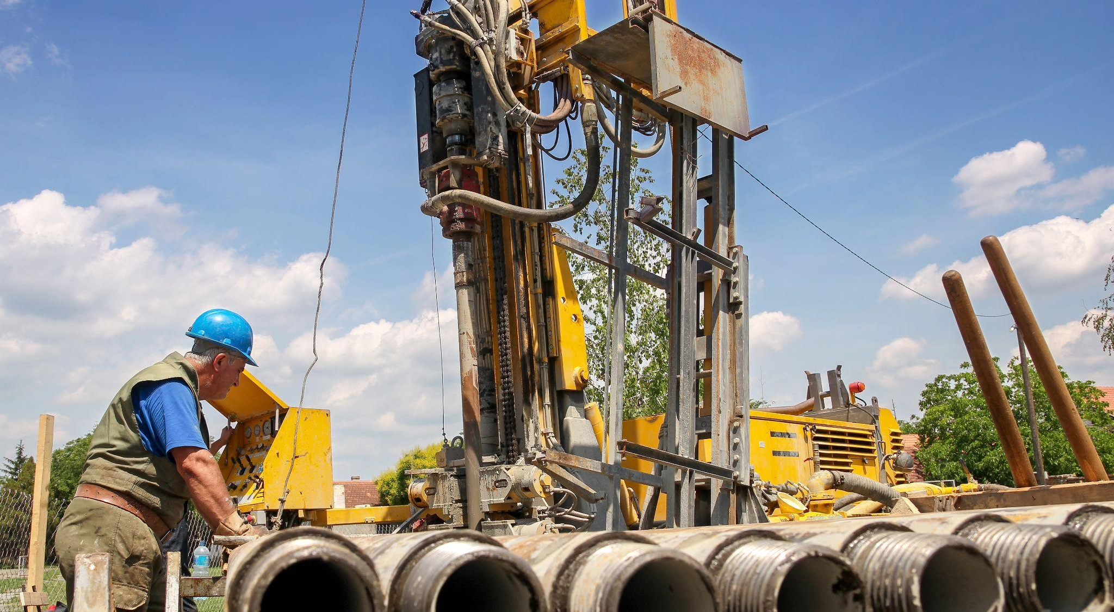
Massachusetts Climate Careers: Powering the Future
Networked Geothermal Projects
Notes:
Today, we’ll explore how communities can use the Earth’s natural heat for clean energy.

Slide 2
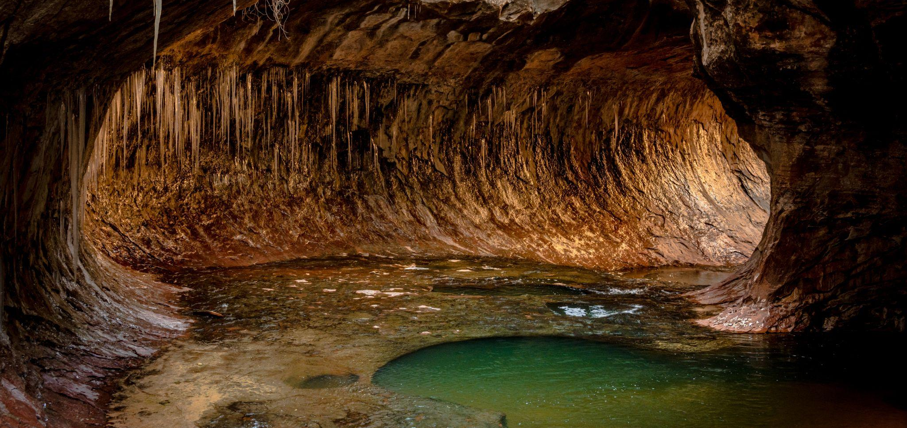
Opening Activity
Why are caves still cool in the summer and warm in the winter?
Lesson 6: Going Deep! Networked Geothermal Projects
Notes:
Activity objective: To familiarize students with the core geothermal concept of underground temperature stability.
Instructions
Ask students to pair themselves with someone nearby.
Students should spend 2 minutes with a partner discussing whether they have been in a basement or cave in the summer and how they would describe it.
It usually feels cooler! It also tends to feel warmer in the winter.
After a few minutes, bring students back together and ask a few people to share aloud, noting consensus or shared themes.
The temperature, 10–15 feet below ground, stays 50–60 degrees all year long.
Ask students for ideas as to why the temperature underground doesn’t change as much as it does above ground. Answer: Earth’s layers are insulating; there is no direct sunlight or wind.
We can use this constant temperature to help heat and cool buildings, reducing our need for fossil fuels.
Today’s lesson is all about geothermal systems, specifically how we may harness that energy and make the most of the climate solution hidden underground.

Slide 3
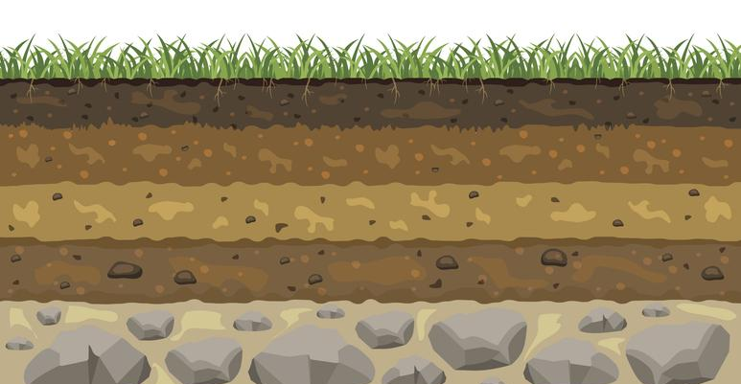
Climate Solutions Hidden Underground
Earth’s temperature remains a constant 50–60°F (10–16°C) all year round, just a few feet below the surface.

Slide 4
Geothermal Systems
Transfer heat from the ground to buildings in winter
Send heat back into the ground in summer
Lesson 6: Going Deep! Networked Geothermal Projects
Notes:
We’ve already learned a bit about heat pumps, and geothermal systems are like nature’s heat pumps.
In the winter, when the air above ground is cooler, geothermal systems bring the heat from below ground up into buildings, raising the temperatures without the need for fossil fuels.
In the summer, they do the same thing in reverse; because the air above ground is warmer, geothermal systems will now push the warmer air back down into the ground, cooling the building.
These systems are distinct from a traditional heating or cooling system because there’s no need to burn fuel to generate the heat or produce energy to create cooler air; the temperature underground remains constant.

Slide 5
In what ways will the use of geothermal energy make our communities cleaner and healthier?
Lesson 6: Going Deep! Networked Geothermal Projects
Notes:
This lesson’s big question focuses on the positive impact that geothermal energy could have on students’ lives and community.
Using geothermal systems can make homes and communities cleaner and healthier.
Reduces greenhouse gas emissions by 60–70%
Lowers electricity use in hot summer months
Provides reliable year-round comfort

Slide 6
My Climate Goals
When you complete this lesson, you’ll be able to:
Explore the science behind networked geothermal systems and how they can contribute to clean heating.
Identify examples of climate-critical professionals who work together to design and implement networked geothermal systems.
Discuss the steps that communities take to explore a solution, such as networked geothermal systems.
Lesson 6: Going Deep! Networked Geothermal Projects

Slide 7
The Big Question and My Climate Goals
Climate Watch and Discussion
Networked Geothermal Systems
Lowell, MA Case Study
Takeaways and Closing
Lesson 6: Going Deep! Networked Geothermal Projects

Slide 8
Geothermal Heroes
Essential geothermal project roles:
Planners: Work with the community to get everyone on board
Engineers: Design systems that use the Earth’s natural heat
Electricians: Connect geothermal energy systems to the energy grid
Lesson 1. Understanding and Combating Climate Change

Slide 9
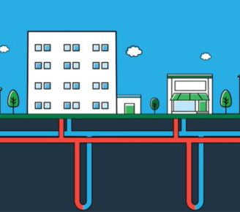
Networked
Geothermal Systems
Networked geothermal systems connect multiple buildings to a single, shared network of pipes called a geothermal loop.
Cost-effective
Energy efficient
Environmentally friendly
Image source: Eversource
Courtesy XXXXXX
Lesson 6: Going Deep! Networked Geothermal Projects
Notes:
Geothermal systems have the most significant impact when networked to provide climate control to multiple buildings.
These systems use a network of pipes to transfer heat, making it possible to heat and cool multiple locations efficiently.
These systems are
cost-effective: Sharing infrastructure reduces costs, so installing one larger system is cheaper than installing multiple smaller ones.
energy efficient: It’s possible to adjust heating and cooling across multiple buildings.
environmentally friendly: These systems reduce reliance on fossil fuels and cut emissions for whole neighborhoods.

Slide 10
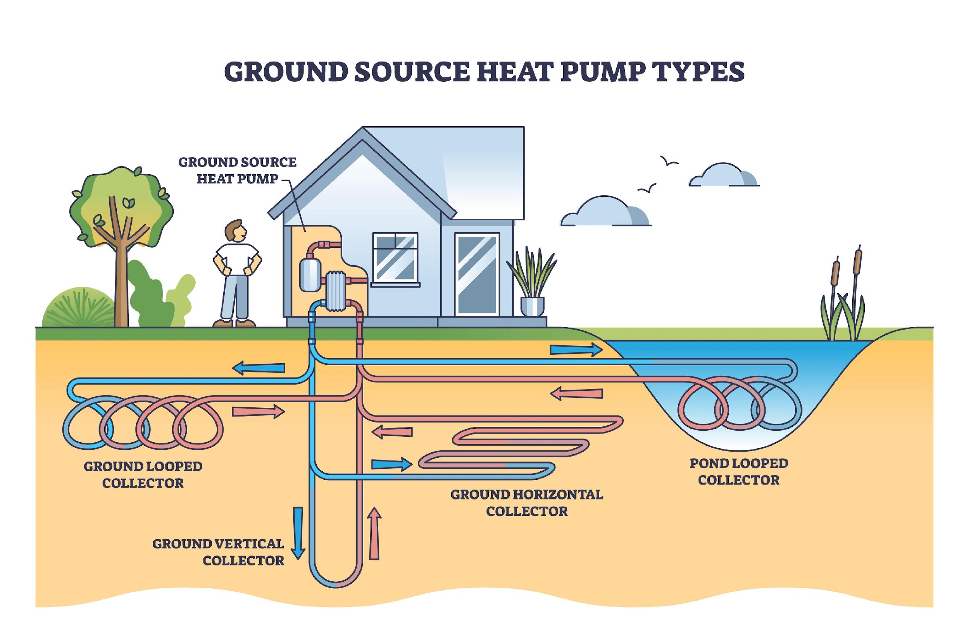
System Types
Courtesy XXXXXX
Lesson 6: Going Deep! Networked Geothermal Projects
Notes:
Choose the right system type for the terrain where the system will be built.

Slide 11
Climate Watch: Video
Courtesy XXX
Lesson 6: Going Deep! Networked Geothermal Projects

Slide 12
Climate Watch Discussion
How is this project using existing infrastructure to speed up the transition to clean energy? Where else might that tactic work?
Several professions and trades were mentioned in the video. Which ones stood out to you or interested you?
The Framingham project relied heavily on community support. What are some ways to rally community interest and support for new clean energy projects like this geothermal project?
Lesson 6: Going Deep! Networked Geothermal Projects

Slide 13
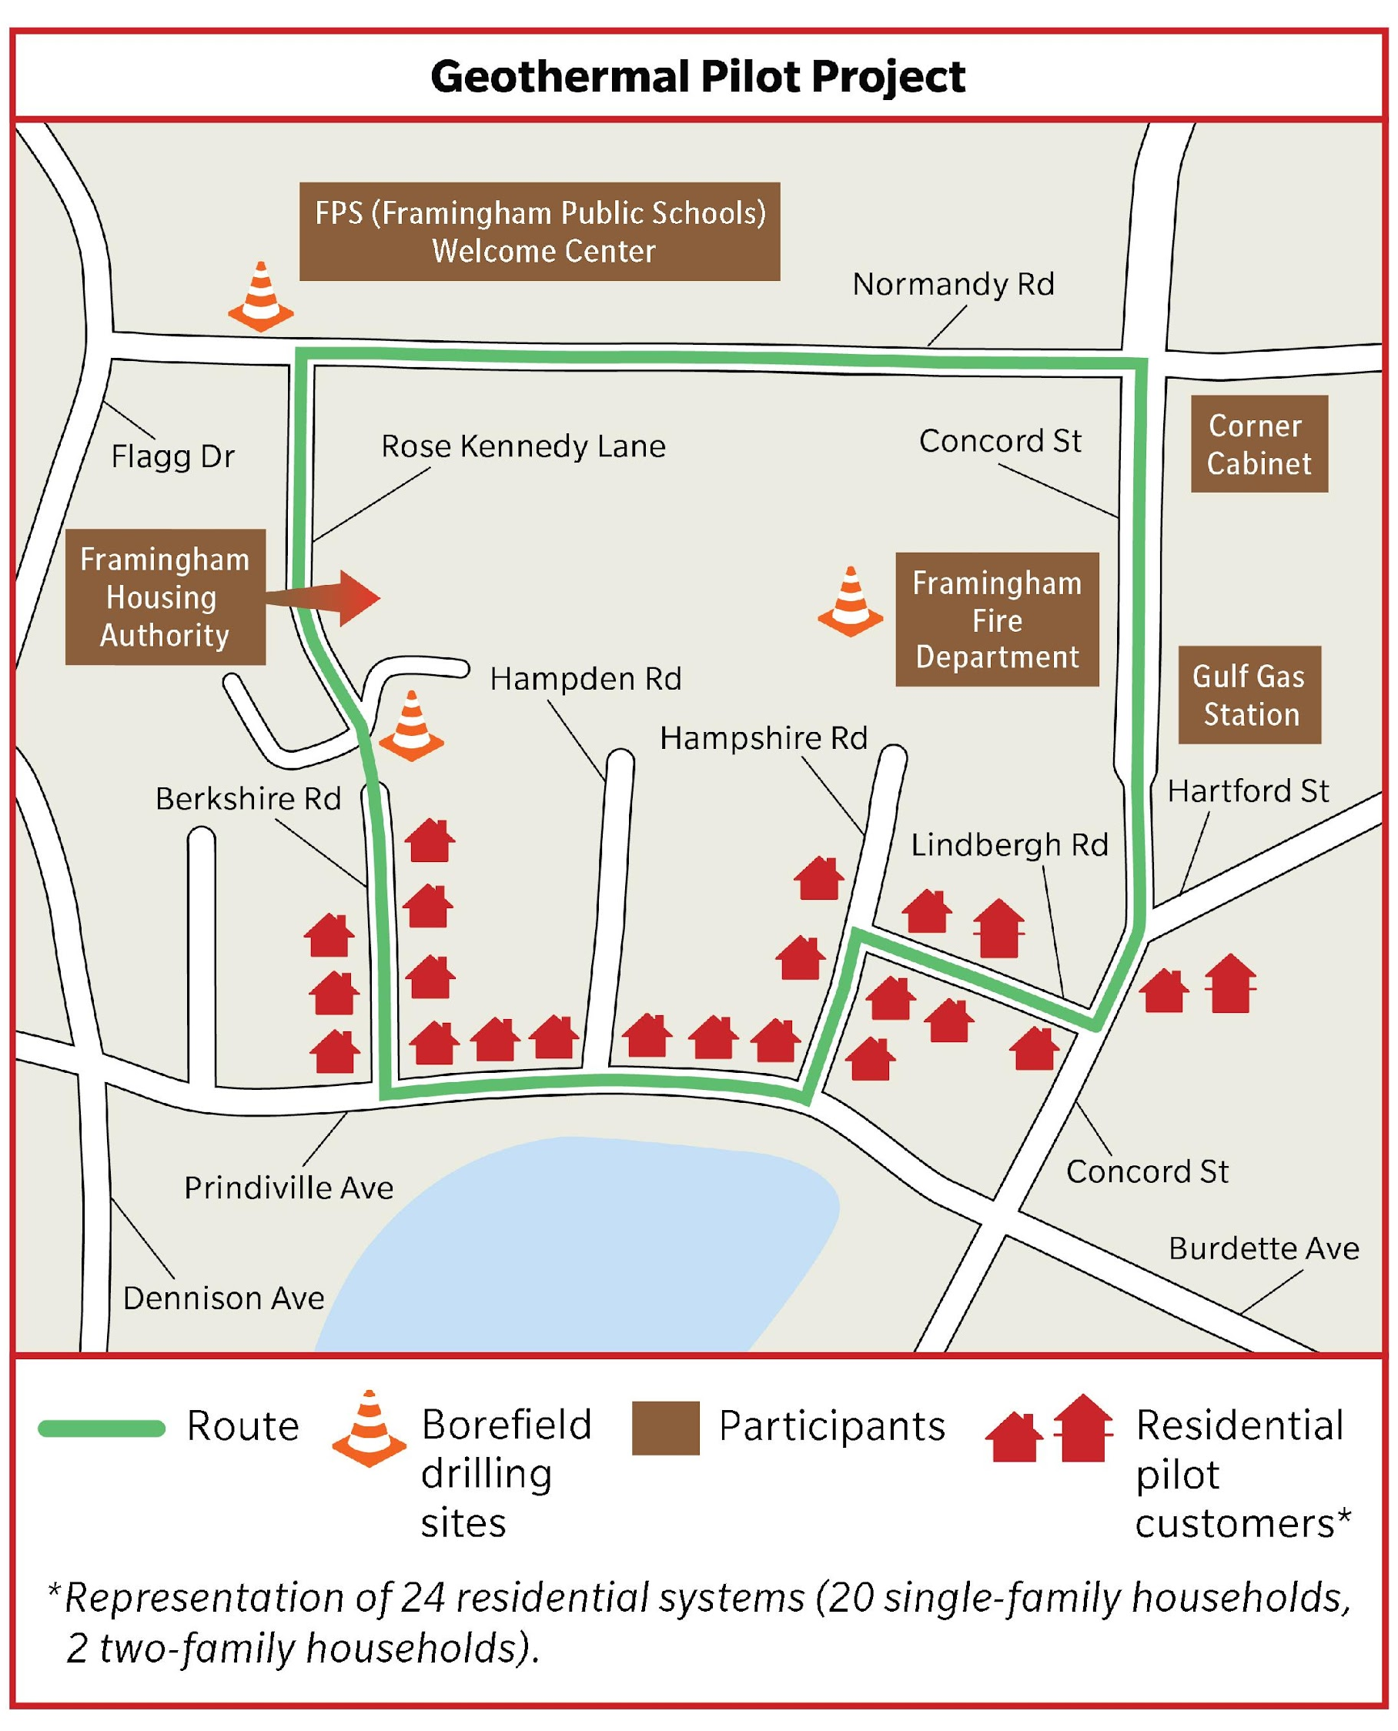
Framingham, MA
Massachusetts is leading the way with geothermal systems!
Three key aspects:
Site selection
Community engagement
Installation and implementation
Image source: Eversource
Lesson 6: Going Deep! Networked Geothermal Projects
Notes:
MA is a leader in clean energy technology and climate goals.
Projects in Framingham and Lowell are examples of networked geothermal systems that help reduce emissions and lower energy costs in those communities.
These projects demonstrate how sustainable, efficient, and reliable energy sources can benefit communities.
You will review the Framingham project together as a class, and then students will work in smaller groups to discuss the Lowell project as a case study.
Students should pay close attention to three aspects of this project:
Site selection: The location of this project was critical. Locations for geothermal systems are chosen based on factors such as soil type (rocky, soft, clay, etc., can support the system), existing infrastructure (number of existing gas or water lines that must be moved, underground tunnels or transit lines, electricity lines, etc.), and proximity to multiple buildings that would benefit from the system. A central location can maximize the benefit of a networked system.
Community engagement: Projects like this require some level of community education because only a few people are familiar with this technology. Others want to know how it will benefit them, how it might disrupt their lives, or what the risks are. Community engagement includes educating the public and providing resources, addressing concerns, and ensuring that residents understand both the benefits and any potential risks or disruptions. Community support is essential for success, which requires time and communication.
Installation and implementation: A geothermal system is set up by installing a series of underground pipes that link to a centralized loop. This process can involve several phases, from when the first plans are made or drilling begins to when homes and business are finally connected to the system.
Successful projects require collaboration between engineers, city planners, businesses, residents, utility workers, and many more people.

Slide 14
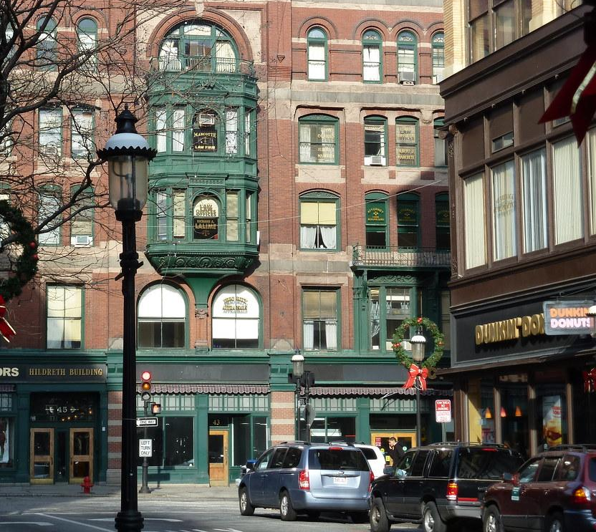
Case Study: Lowell, MA Geothermal Project
Read and analyze the case study on your worksheet.
Why is Lowell interested in geothermal energy over other energy sources?
What steps did Lowell take to prepare its community for a geothermal project?
What are some of the possible impacts of geothermal energy on this community?
Present your findings to the class!
Lesson 6: Going Deep! Networked Geothermal Projects
Notes:
Activity objective: Provide a real-world example of geothermal exploration, and invite students to analyze and discuss the practicalities of community engagement for large-scale geothermal projects.
Instructions
Divide students into groups. This activity requires them to analyze a narrative case description, which may be difficult for some students.
Groups will review details of the Lowell geothermal project plan, including project goals, National Grid’s geothermal system setup, and community engagement efforts (mailings, meetings, milestones).
In their groups, students will discuss Lowell’s interest in geothermal energy, their preparation and community engagement efforts, and the possible impact of a geothermal system on their community.
Following the prompts on their worksheet, each group will create a short summary of what they think were the most important steps in gaining community support. Groups will present their findings to the class during the debrief discussion.
For the debrief discussion: Invite groups to share their insights on the most important steps Lowell took to gain community support for their geothermal project.
Background on the Lowell geothermal project to help guide the discussion
Steps Lowell took to prepare the community:
Engaged the community:
Hosted public forums and informational sessions to educate residents about geothermal energy and its benefits
Partnered with local schools and organizations to increase awareness and understanding
Conducted feasibility studies:
Collaborated with energy experts to assess the city’s geology and determine the feasibility of geothermal systems
Identified neighborhoods where a geothermal system could be most effectively implemented
Ran pilot programs:
Developed a pilot program to test geothermal systems in specific areas, gathering data on performance and community impact
Worked with utility companies to explore the integration of geothermal energy into existing energy systems
Potential impacts of geothermal energy on the community:
Environmental benefits: Reduces reliance on fossil fuels, lowering greenhouse gas emissions; decreases air pollution, improving public health.
Economic benefits: Provides stable, lower-cost heating and cooling options for residents and businesses; creates local jobs in the clean energy sector.
Social benefits: Builds community resilience by providing reliable energy during extreme weather events; strengthens Lowell’s role as a leader in innovative, sustainable energy solutions.
Debrief discussion:
What were the most significant benefits of the Lowell geothermal project for the community and why?
What challenges did the Lowell community face in implementing the geothermal project, and how were they addressed?
How could similar geothermal projects be used in other communities?

Slide 15
Geothermal energy is a clean and renewable solution.
Community engagement and education are crucial to the success of geothermal and similar projects.
Geothermal projects have environmental, economic, and social benefits.
Geothermal projects require careful planning, and conducting feasibility studies and pilots may help determine the best locations and practices for long-term success.
Lesson 6: Going Deep! Networked Geothermal Projects

Slide 16
Closing Activity
What kinds of community outreach or education would be necessary to gain support for a geothermal system in your community?
Lesson 6: Going Deep! Networked Geothermal Projects
Notes:
Activity objective: Students will translate the activity and the concepts of the lesson into their own community. They will be encouraged to think about the long-term community engagement and education efforts required for climate projects.
To close out the class, invite students to respond to this prompt: What steps do students believe would help gain support for a project like this in their own community?

