Slide 1
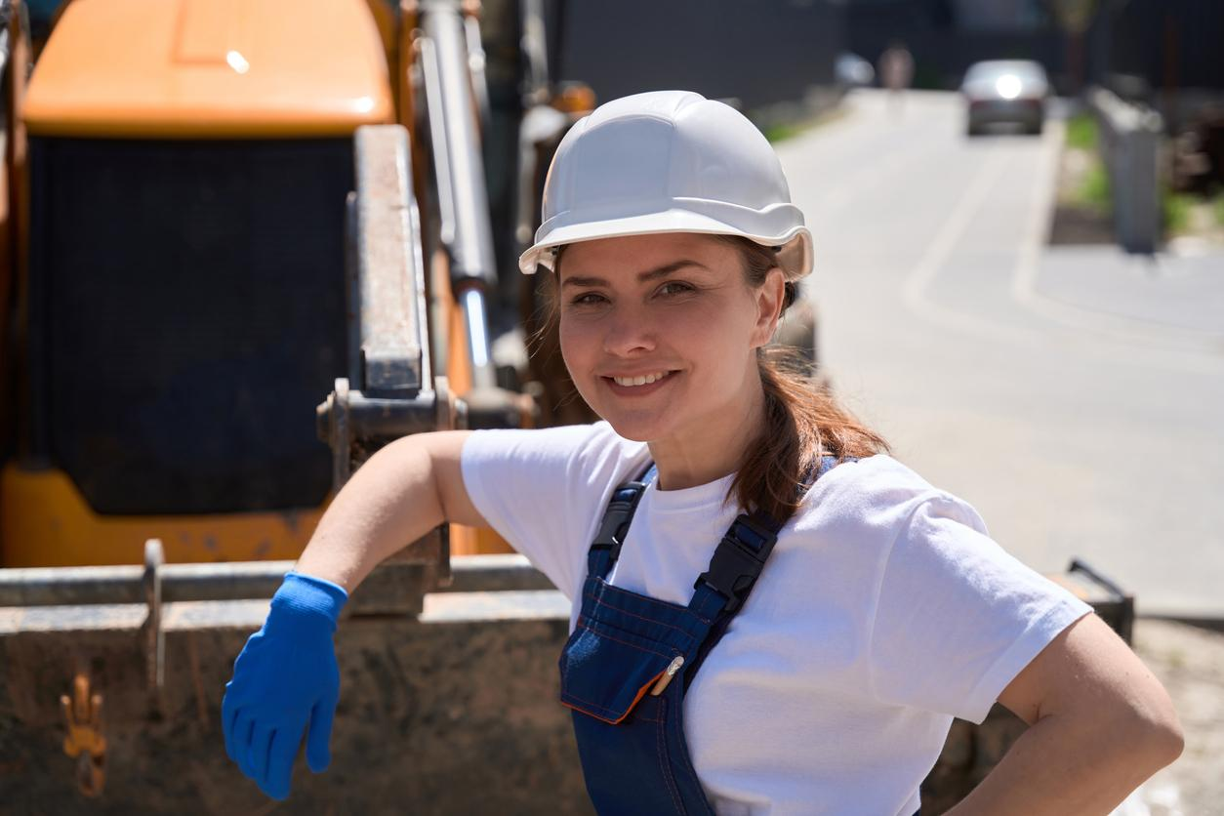

Massachusetts Climate Careers: Powering the Future
Understanding and Combating
Climate Change
Lesson 1. Understanding and Combating Climate Change
|
1
Notes:
Ask students to raise their hands if they know what climate change is.
Ask a few students to briefly describe climate change, and invite other students to add to what they say.
In this class, we will do much more than talk about climate change. We’ll discuss what we, specifically you, can do to prevent climate change, the actions that cause it to get worse, and, ideally, ways we can help improve things.

Slide 2
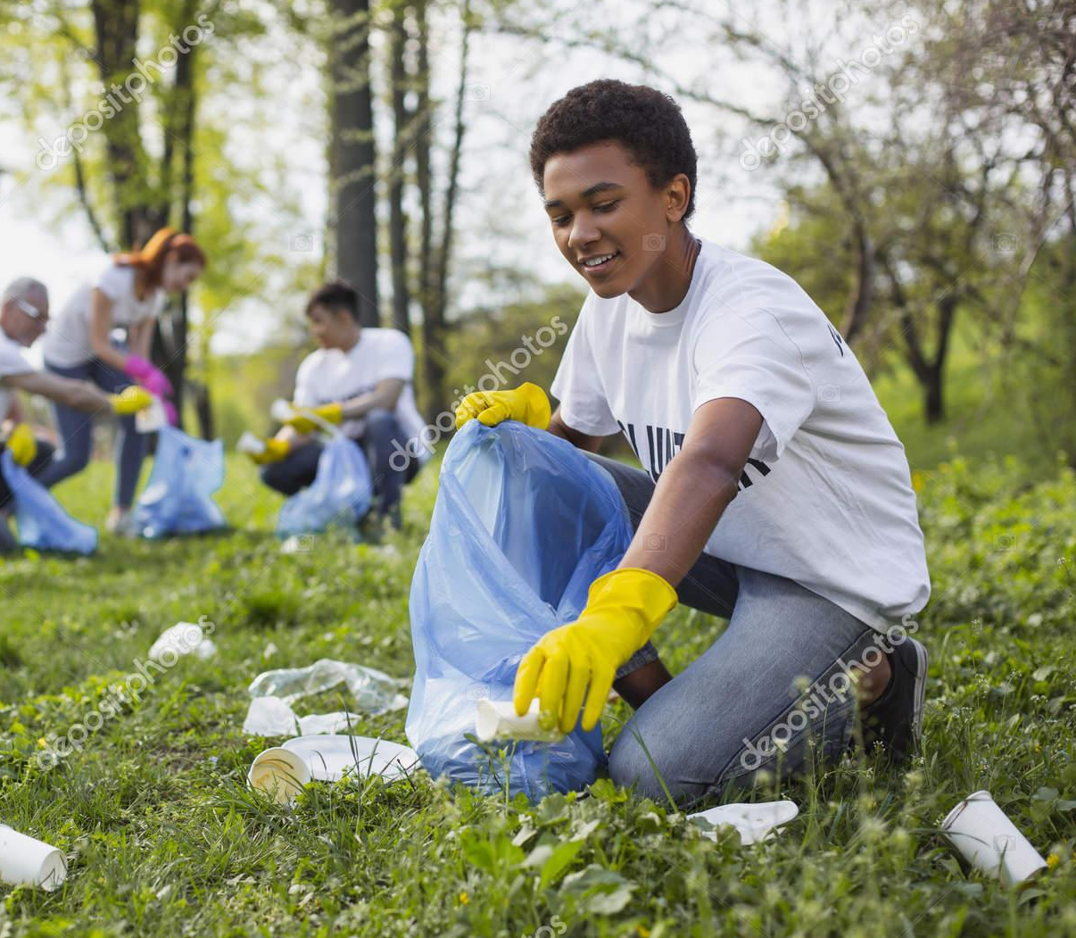
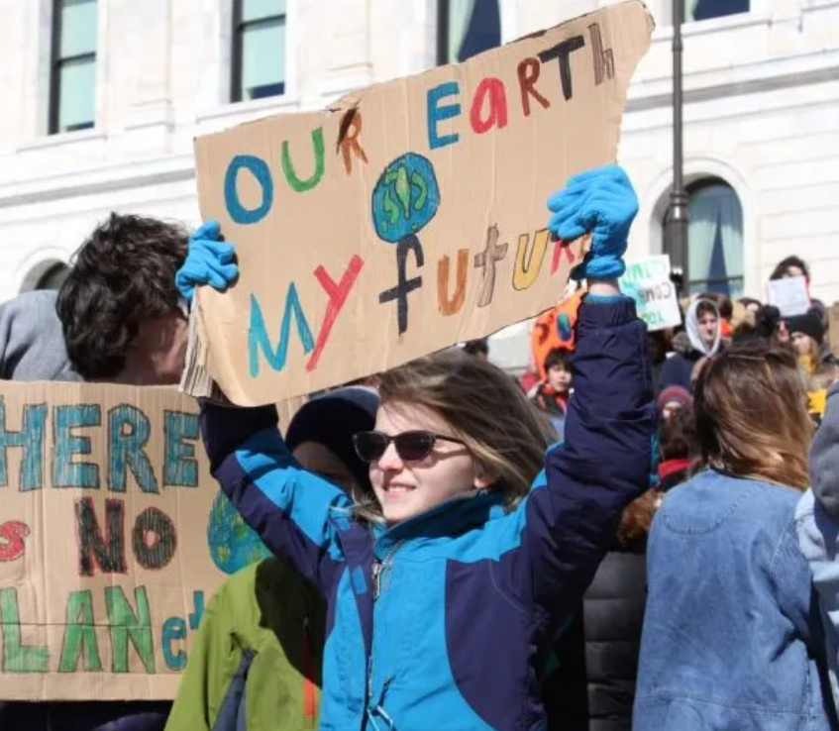
Youth Lead the Fight Against Climate Change
Youth climate strike. Creative Commons
Lesson 1. Understanding and Combating Climate Change
Notes:
Quickly introduce the lesson structure so that students know what to expect.
Today’s focus will be on learning how climate change affects our lives and how we can be part of the solution.
Key point to emphasize: This is an exciting opportunity to see how you can make a difference now and in the future.

Slide 3
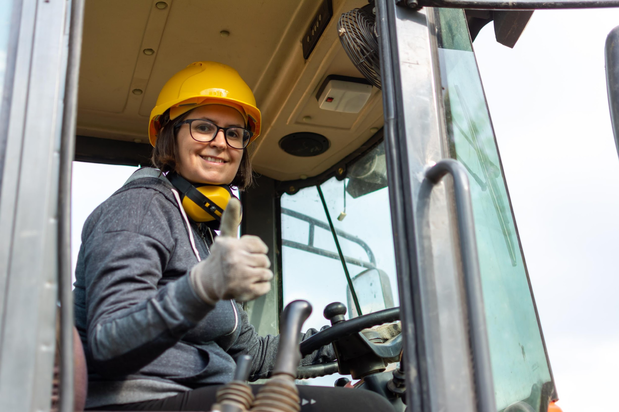
Today’s Agenda
Climate Change
The Big Question and My Climate Goals
Today’s Group Activity
Climate Watch and Discussion
Closing Activity
Lesson 1. Understanding and Combating Climate Change
Notes:
Quickly introduce the lesson structure so that students know what to expect.
Today’s focus will be on learning how climate change affects our lives and how we can be part of the solution.
Key point to emphasize: This is an exciting opportunity to see how you can make a difference now and in the future.

Slide 4

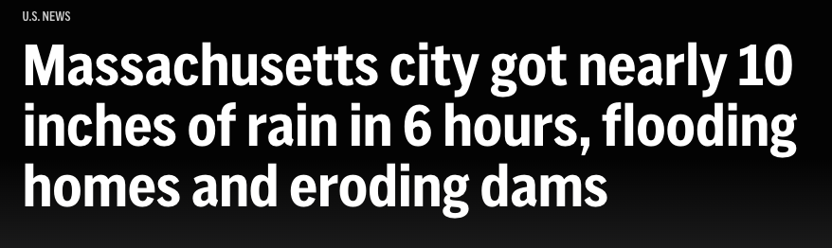
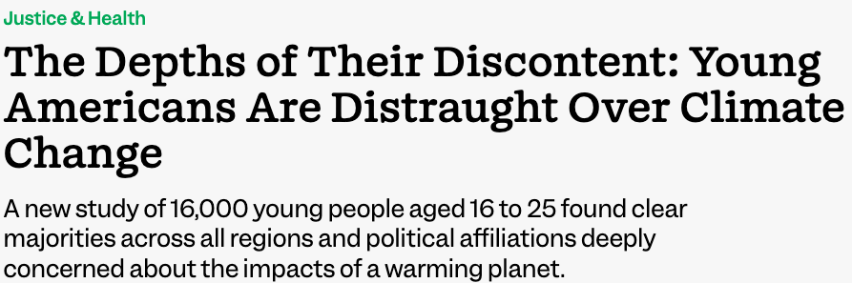
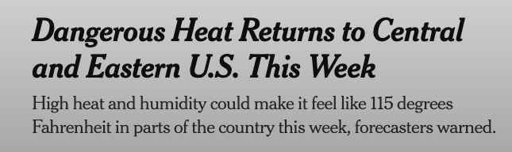
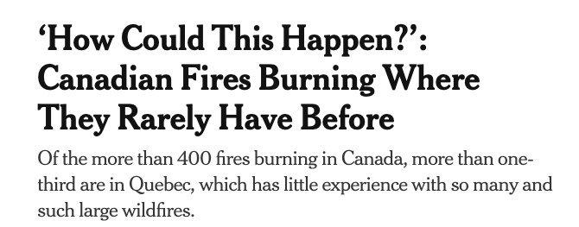
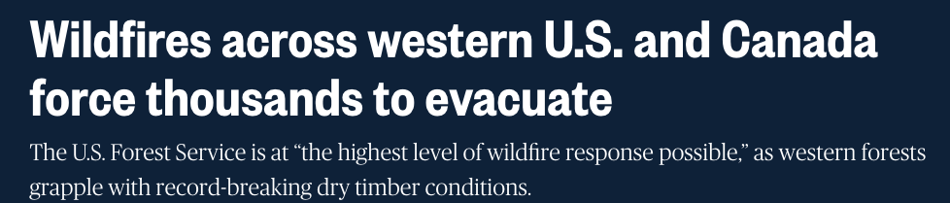
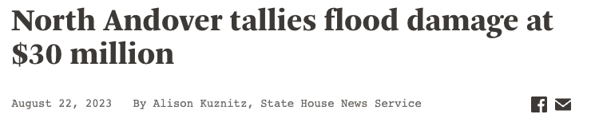
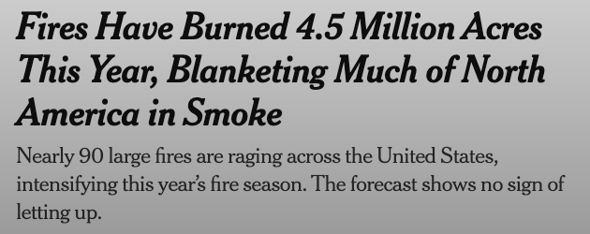
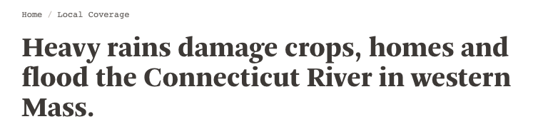
Opening Activity
Climate Change in the Headlines
Lesson 1. Understanding and Combating Climate Change
Notes:
Opening activity. Get students thinking and talking right away.
Activity objective: Get students thinking about the impact climate change has on us based on recent headlines about climate-related crises.
Present the slide of headlines. Direct students to form pairs with someone nearby.
Pair and Share: Partners share a climate change-related news story they’ve heard recently. If they can’t think of one, they can discuss one of the headlines on the slide.
Partners discuss what they notice about climate in the headlines and how it makes them think about the future of clean energy.
Bring the class back together and ask: “How do you think climate change could affect your community or future?”
After a few students share, transition: “Today, we’re going to learn how climate change impacts all of us and how we can be part of the solution.”

Slide 5
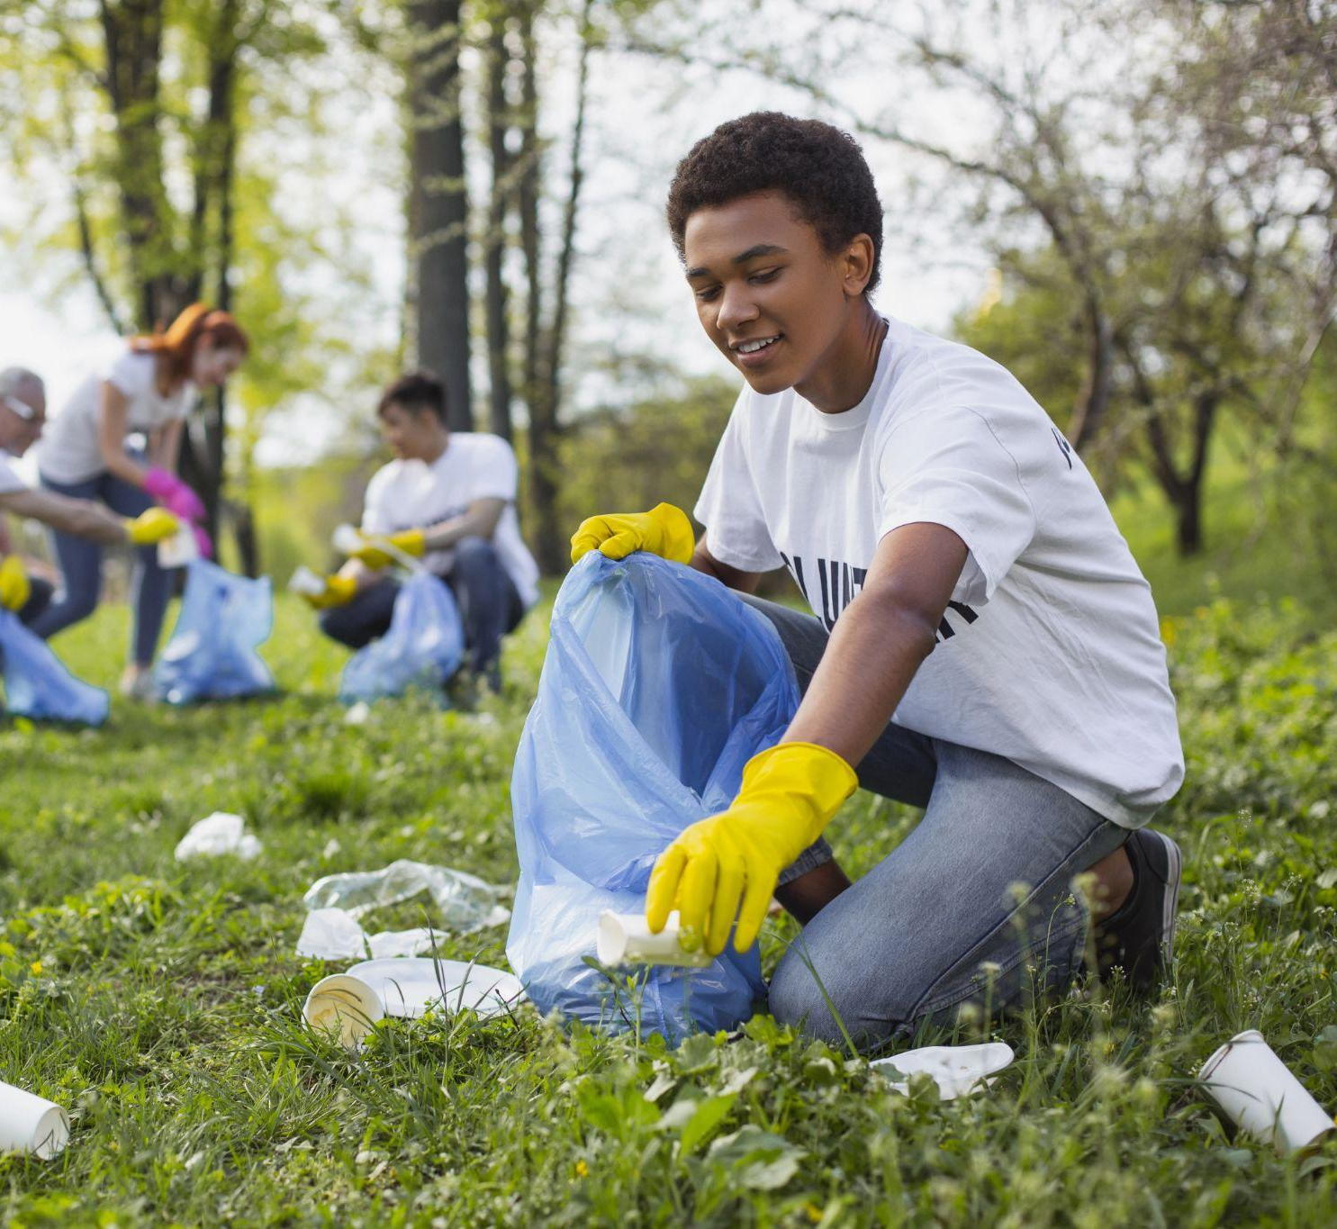
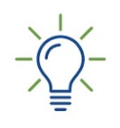
How does climate change affect my life and community, and how can I actively participate in its solution?
The Big Question
Lesson 1. Understanding and Combating Climate Change
Notes:
Quickly introduce the lesson structure so that students know what to expect.
Today’s focus will be on learning how climate change affects our lives and how we can be part of the solution.
Key point to emphasize: This is an exciting opportunity to see how you can make a difference now and in the future.

Slide 6


When you complete this lesson, you’ll be able to:
Identify and explain the consequences of climate change.
Identify at least three ways your community can address climate change.
Discuss how you can help combat climate change today and in the future.
My Climate Goals
Lesson 1. Understanding and Combating Climate Change

Slide 7
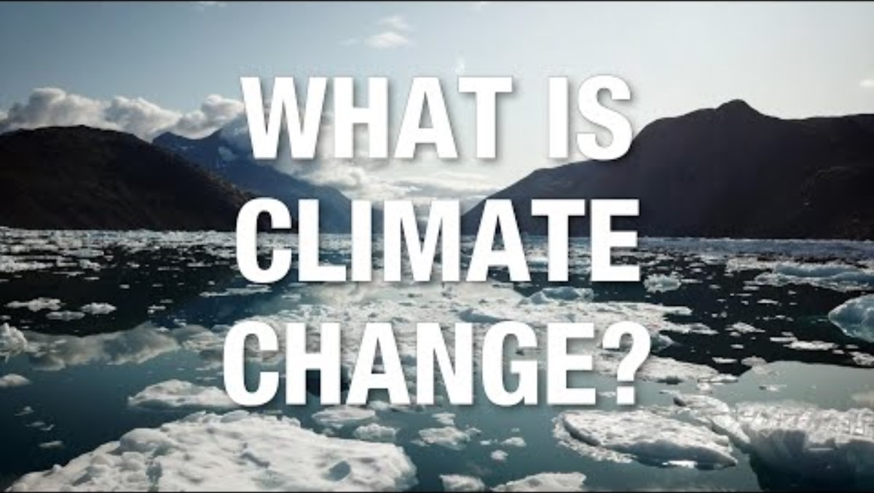
Climate Watch: Video
Lesson 1. Understanding and Combating Climate Change

Slide 8
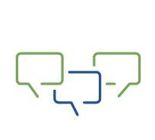
Share what you learned from the video, and listen to your classmates’ perspectives.
What interested you most in the video?
How do you see yourself being part of the solution?
Climate Watch Discussion
Lesson 1. Understanding and Combating Climate Change

Slide 9
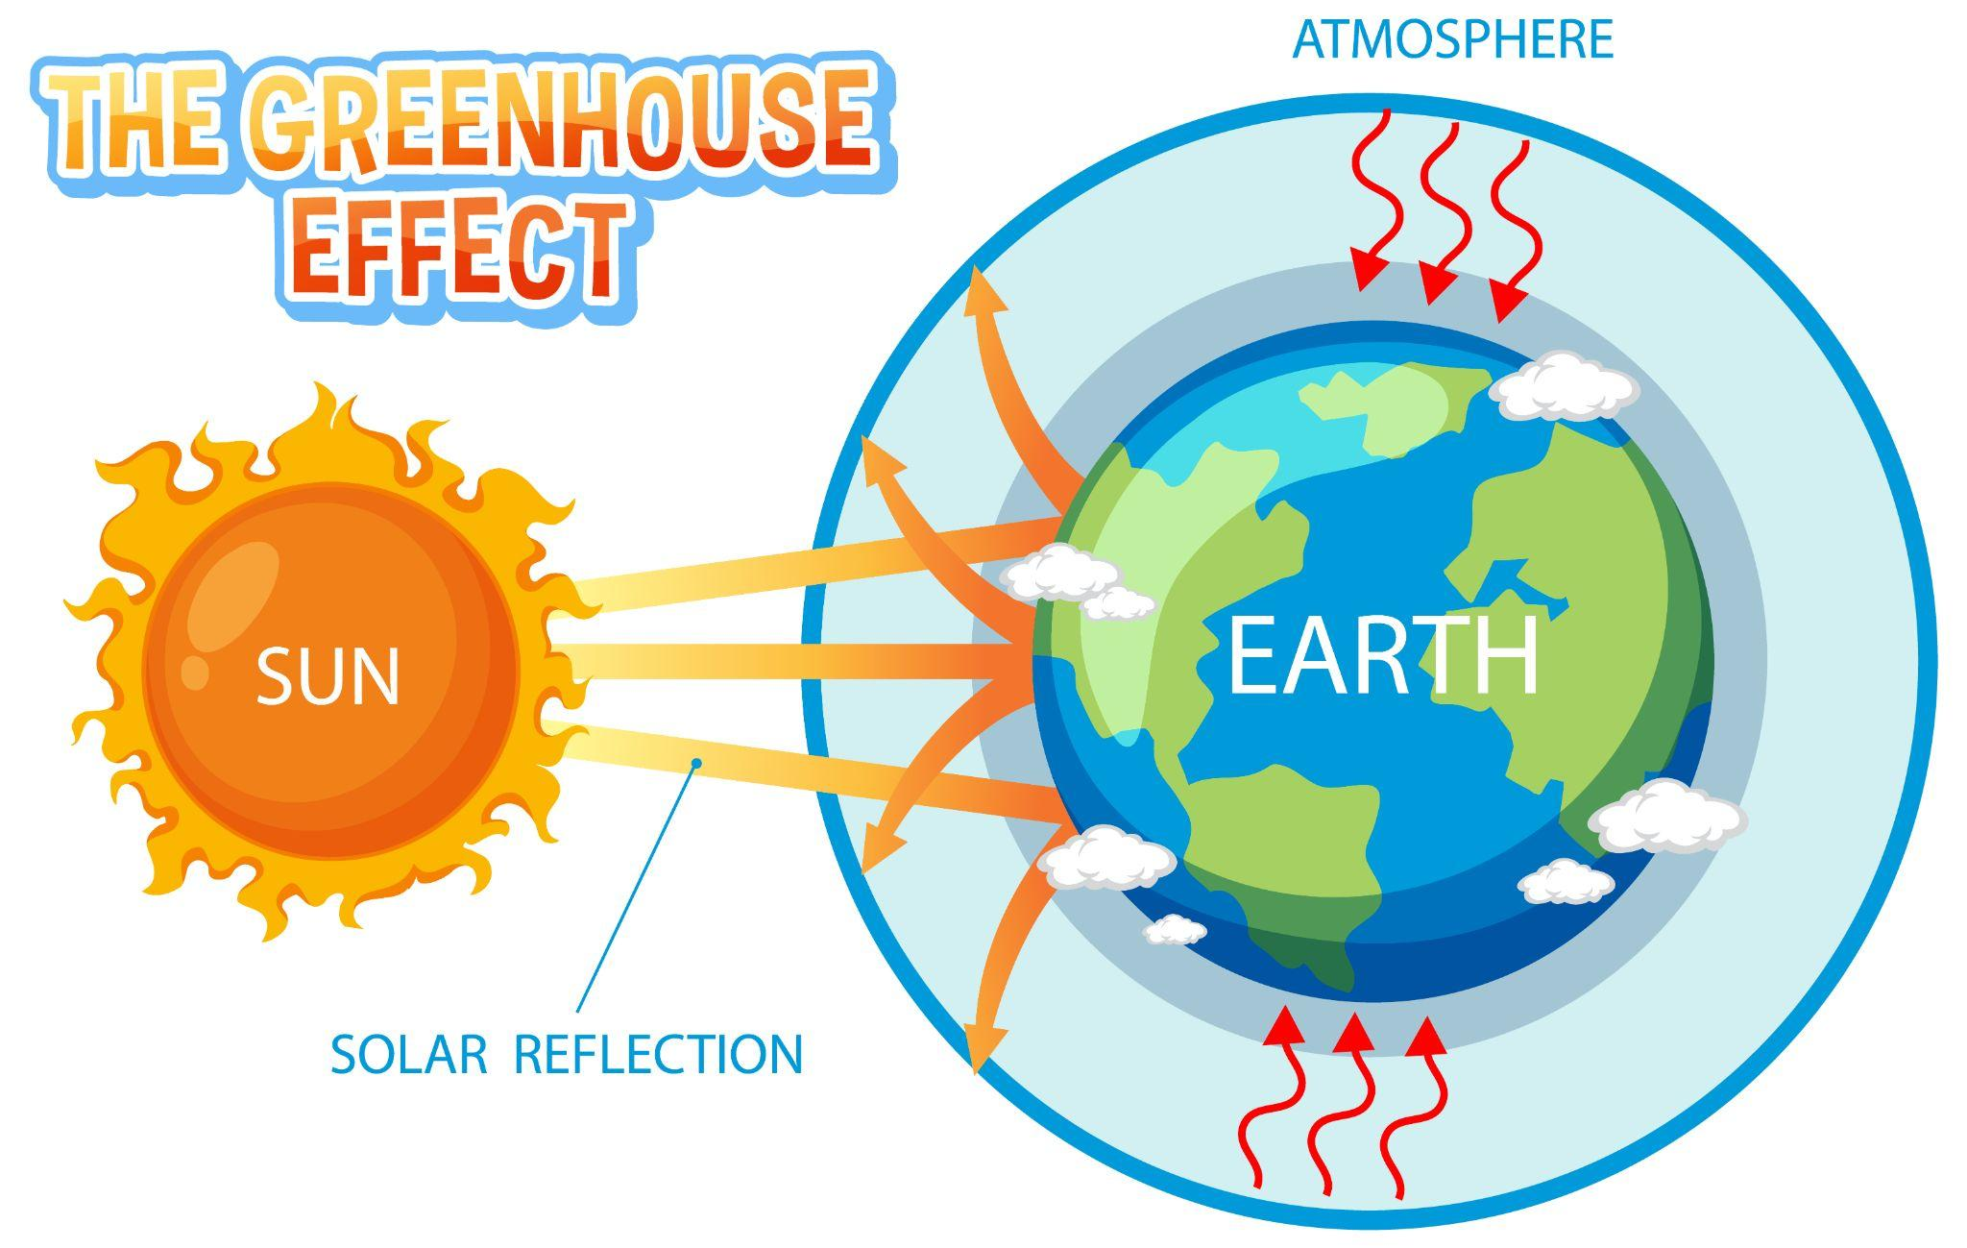
What Causes Climate Change?
Greenhouse gases in the atmosphere are like a blanket wrapped around the planet, keeping heat in.
Courtesy XXXXXX
Lesson 1. Understanding and Combating Climate Change
Notes:
Use the image or infographic to explain the greenhouse effect and trapped heat as a primary explanation and cause of climate change.
Climate change is driven by human activities, such as burning fossil fuels.
Possible student question:
“Can natural processes cause climate change, too?”
Yes, but the current changes and the rate of climate change we’re experiencing are mainly due to human activities.

Slide 10
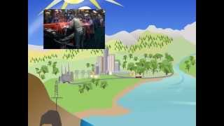
Greenhouse Gas Effect
Video: EPA.gov
Lesson 1. Understanding and Combating Climate Change
Notes:
Video: EPA (2 mins)
Before the video, tell students this will help to explain how the greenhouse effect warms the planet.
Human actions, such as burning fossil fuels, lead to more greenhouse gases in the atmosphere, which trap heat and warm the planet.
The greenhouse effect leads to extreme weather, rising sea levels, and ecosystem changes, affecting our lives.

Slide 11
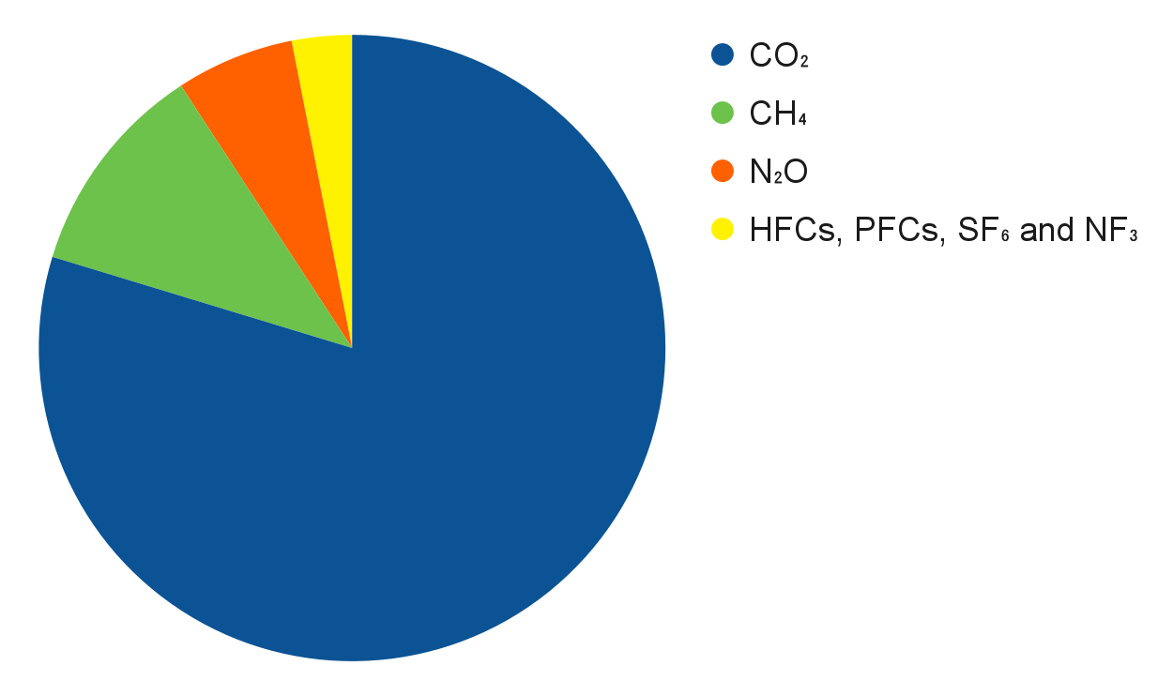
Types of Greenhouse Gases
F-gases
Nitrous Oxide
Methane
Carbon Dioxide
Image: EPA.gov
Courtesy XXXXXX
Lesson 1. Understanding and Combating Climate Change
Notes:
Carbon dioxide is the primary greenhouse gas contributing to recent climate change. Carbon dioxide enters the atmosphere through burning fossil fuels, solid waste, trees, and other biological materials and as a result of certain chemical reactions, such as cement manufacturing. Carbon dioxide is absorbed and emitted naturally as part of the carbon cycle, through plant and animal respiration, volcanic eruptions, and ocean-atmosphere exchange.
Both natural and human activities produce methane. For example, natural wetlands, agricultural activities, and fossil-fuel extraction and transport all emit methane.
Nitrous oxide is mainly produced through agricultural activities and natural biological processes. Fossil-fuel burning and industrial processes also create nitrous oxide.
Chlorofluorocarbons, hydrochlorofluorocarbons, hydrofluorocarbons, perfluorocarbons, and sulfur hexafluoride, together called F-gases, are often used in coolants, foaming agents, fire extinguishers, solvents, pesticides, and aerosol propellants.

Slide 12
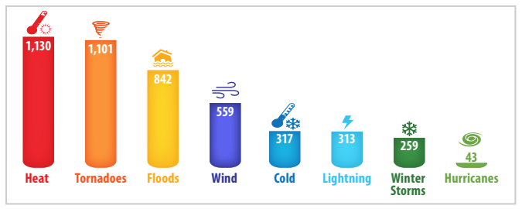
Fatalities by Weather-Related Hazards 2006–2015
Consequences: Health Risks—Extreme Heat
Image: EPA.gov
Lesson 1. Understanding and Combating Climate Change
Notes:
Extreme heat causes more deaths than any other weather-related hazard—more than hurricanes, tornadoes, or flooding. In addition, thousands of people exposed to extreme heat seek medical treatment each year.
More than 65,000 Americans visit an emergency room each summer for acute heat illness.
This shows why addressing climate change is urgent.
Key point to emphasize: Rising temperatures are not just inconvenient but dangerous, especially for vulnerable populations.
Sources:
[source:stat source: U.S. Global Change Research Program. “The Impacts of Climate Change on Human Health in the United States: A Scientific Assessment.” Last modified 2016. https://health2016.globalchange.gov]
Graph: Numbers in each bar represent the total number of fatalities by hazard. Source: NOAA National Weather Service, 2016
Source: EPA Guidebook Extreme Heat
https://www.epa.gov/sites/default/files/2016-10/documents/extreme-heat-guidebook.pdf

Slide 13
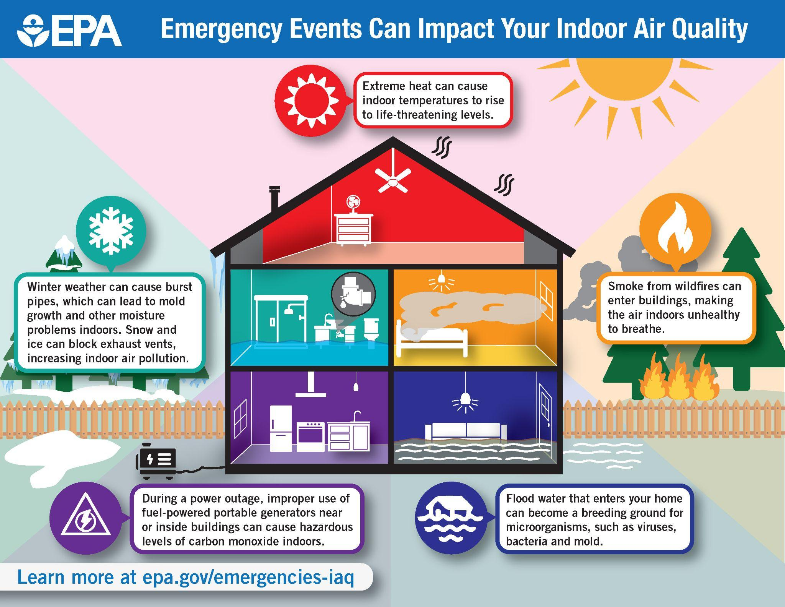
Consequences: Health Risks— Air Quality
Image: EPA.gov
Lesson 1. Understanding and Combating Climate Change
Notes:
Climate change can also impact human health by worsening air and water quality, increasing the spread of certain diseases, and altering the frequency or intensity of extreme weather events.
[Image source: https://www.epa.gov/emergencies-iaq/emergency-events-can-impact-your-indoor-air-quality-infographic]

Slide 14
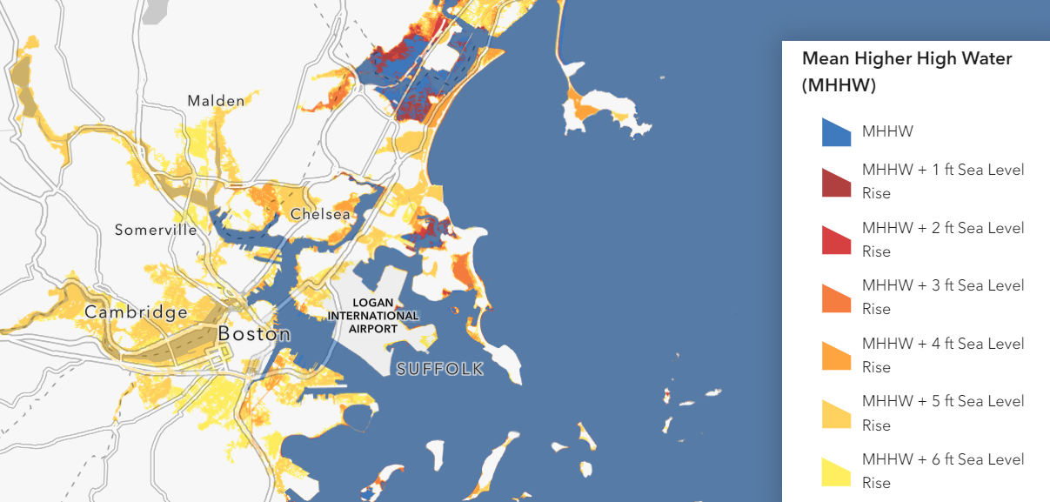
Consequences: Rising Sea Levels
Sea-Level Rise and Coastal Flooding Viewer
Source: MA Office of Coastal Zone Management
Lesson 1. Understanding and Combating Climate Change
Notes:
This map shows the estimated sea-level rise around Boston.
How would you feel if your favorite beach was underwater due to rising sea levels? What about where you went fishing or where you used to go swimming or ice skating?
Ask students if anyone has an example of an area where they’ve seen a difference in the waterline or coastline in their lifetime.
Changes in rainfall can result in more floods, droughts, or intense rain. Heavy rainfall and overwhelmed drainage systems can also damage inland buildings.
In the bigger picture, rising sea levels threaten coastal communities and ecosystems, communities along rivers, and eventually communities near lakes and ponds or any community near water.
Interactive tools can be linked to from: Massachusetts Sea Level Rise and Coastal Flooding Viewer
[Image source: https://experience.arcgis.com/experience/23d861b79aed450eb8972013dd28579b/page/Sea-Level-Rise/]
“This interactive map shows the National Oceanic and Atmospheric Administration (NOAA) “bathtub” modeling of coastal flooding above Mean Higher High Water (MHHW, the average height of daily highest tides) with six scenarios showing increasing levels of sea level rise (one-foot increments up to six feet). This static “bathtub” model does not account for storm surge, waves, erosion, and other dynamic factors.”

Slide 15
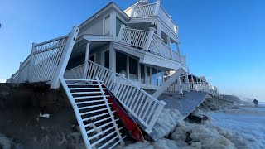
Climate Change Impacts Communities
January 2024
Lesson 1. Understanding and Combating Climate Change
Notes:
Here is another look at a community hit by a recent storm surge.
Video (2 mins)
WCBV Channel 5 Boston. “Storm Surge, Flooding Cause Major Home Damage in North Shore Town.” Posted January 13, 2024. YouTube, 1:58. https://youtu.be/KaxrEI4Miyk?si=76TartjfU2aj2Fy9

Slide 16
Climate Change Impacts Communities
Share what you learned from the video, and listen to your classmates’ perspectives.
What are some of the ways the flooding impacted individuals?
What impact did it have on the community?
Consider the image of potential sea-level rise in Boston. What impact will changes like that have on communities there?
Lesson 1. Understanding and Combating Climate Change
Notes:
Continue the discussion about how climate change impacts communities by asking questions about the video.

Slide 17

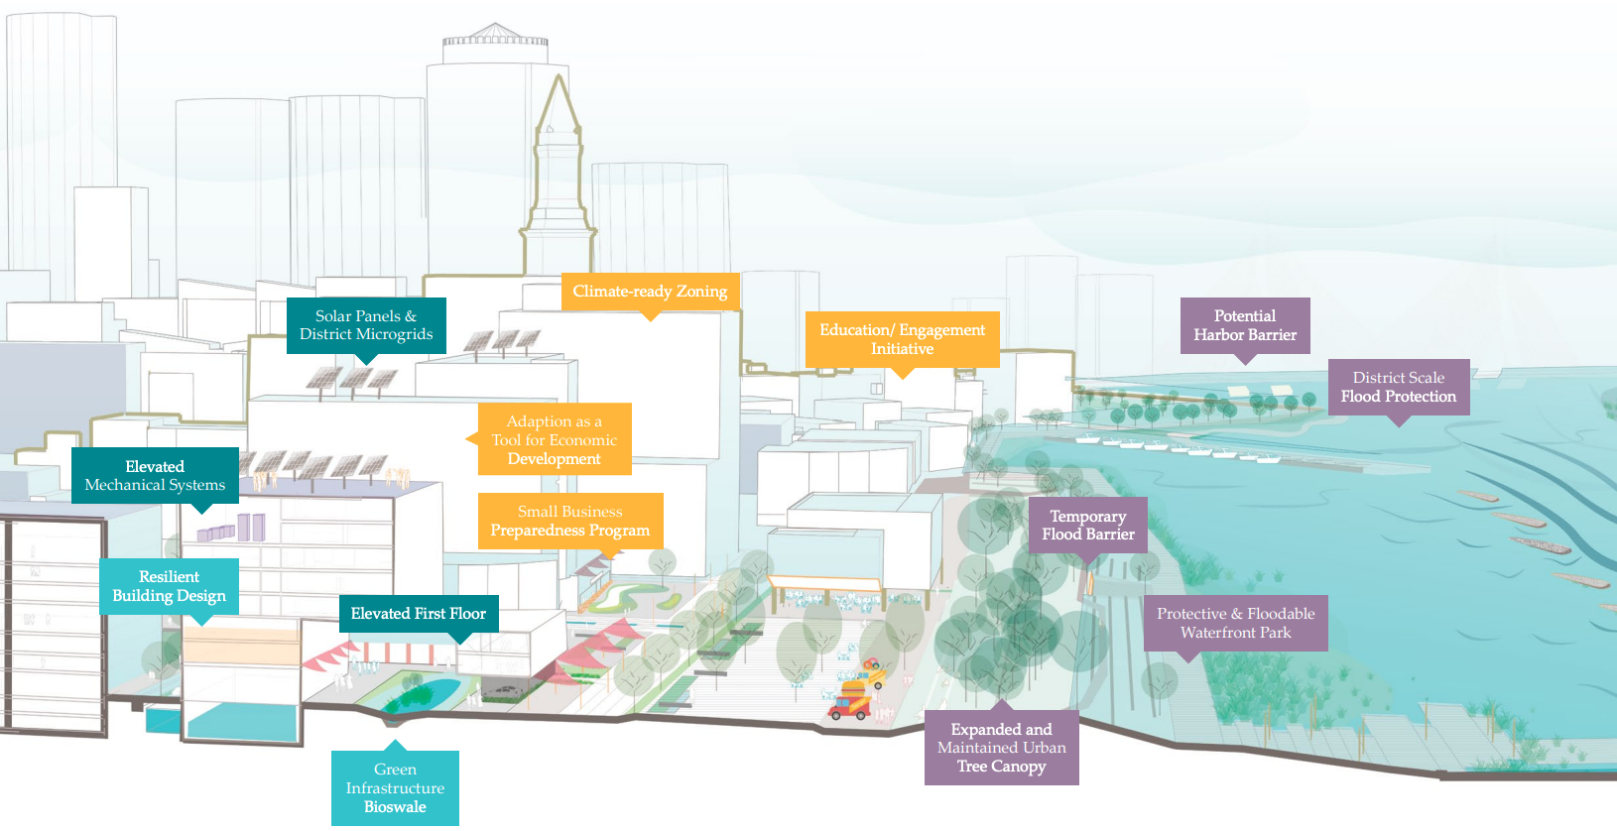
Today’s Group Activity
Building Boston’s Climate Resilience
Lesson 1. Understanding and Combating Climate Change
Notes:
Activity objective: Students will learn about several of Boston’s Climate Action Plan strategies to reduce emissions and improve climate resilience. This activity will foster collaboration, deepen understanding of real-world climate strategies, and show how local action contributes to climate goals.
Instructions:
Divide students into groups based on three categories. (Depending on class size, you may choose to have more than one group focusing on each of the categories below):
Buildings
Transportation
Everything else (energy efficiency, waste reduction, green spaces)
Direct students to their worksheet, which they will use to complete this activity. On the worksheets, each category lists three to four strategies from Boston’s Climate Action Plan.
Each group should
Choose one or two strategies from their category to focus on; they should choose the strategy or strategies they find most exciting or believe will be the most impactful
Discuss how their chosen strategy will help Boston now and in the future
Answer the questions in their worksheets.
Groups will present to the rest of the class. Each group should take about one minute to summarize the main points:
Their chosen strategy and its benefits for Boston’s communities
How it contributes to climate resilience
Key concept to highlight: Climate resilience is essential; holistic approaches in cities such as Boston can serve as models for other communities.
Potential student question: “Why are we looking at Boston’s climate plan and not other towns?”
The Climate Ready Boston initiative is an example that is more fully developed than in many other cities and towns. This initiative was intended to produce a systemic and comprehensive framework. This framework was developed by working with local climate scientists, engineers, planners, and designers to identify vulnerable locations and engage in changes to promote resilience.

Slide 18
Activity Debrief
Building Boston’s Climate Resilience
Lesson 1. Understanding and Combating Climate Change
Notes:
Debrief discussion: Which strategies surprised you as being used to combat climate change?
Encourage discussion on how these strategies connect to one another and to broader systems across the state and region.
The city is promoting transit-oriented development (TOD) to reduce the climate impact of new growth and development, especially in highly populated areas.
Transitioning to the use of zero-net carbon methods and materials for new construction
Adoption of zero-emission vehicles making our energy supply cleaner and more resilient
Climate action plans in the northeast are increasingly including nature-based solutions, such as planting urban trees and building green infrastructure for slowing and holding stormwater runoff
Key concept to highlight: Climate resilience is essential; holistic approaches in cities such as Boston can serve as models for other communities.

Slide 19
Key Points
Climate change is a long-term shift in global or regional climate patterns, primarily caused by humans.
Greenhouse gasses in the atmosphere trap heat, making the planet warmer.
Climate change can lead to health risks from extreme heat and worsening air quality, extreme weather, and sea level rise.
I can take action to slow climate change.
Lesson 1. Understanding and Combating Climate Change

Slide 20
Before You Go
What is one change you can make immediately that will slow climate change?
What are three ways your community can help address climate change?
Closing Activity
Lesson 1. Understanding and Combating Climate Change
Notes:
Activity objective: Encourage students to reflect on key takeaways and identify areas of curiosity for further exploration.
What is one change you can make immediately that will slow climate change?
Imagine the future. What will happen if more people like you make just one change?
Check individual understanding of Learning Objectives.
Write a sentence or two to share your thoughts about the following questions.
What are two consequences of climate change?
In what way does climate change affect your life?
How does (or how can) your community address climate change?
What is one way you will help combat climate change?

Slide 21
Lesson Exit Ticket
Reflect on What You Learned Today
Write a sentence or two to share your thoughts about the following questions.
What are two consequences of climate change?
In what way does climate change affect your life?
How does (or how can) your community address climate change?
What is one way you will help combat climate change?
Lesson 1. Understanding and Combating Climate Change

